Slide 1

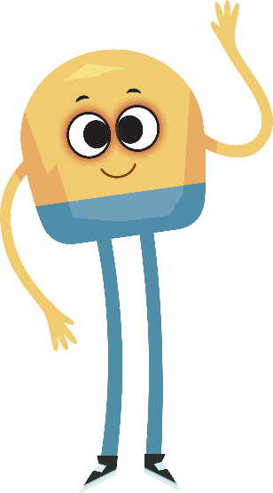

Unit 2: Week 5
Grade K

Slide 2
Copyright © Savvas Learning Company LLC. All Rights Reserved.
This publication is protected by copyright, and permission should be obtained from the publisher prior to any prohibited reproduction, storage in a retrieval system, or transmission in any form or by any means, electronic, mechanical, photocopying, recording, or otherwise. For information regarding permissions, request forms, and the appropriate contacts within the Savvas Learning Company Rights Management group, please send your query to:
Savvas Learning Company LLC, 15 East Midland Avenue, Paramus, NJ 07652
or
k12learningpermissions@savvas.com
myView Literacy® is an exclusive trademark of Savvas Learning Company LLC in the U.S. and/or other countries.

Slide 3

Lesson 1

Slide 4
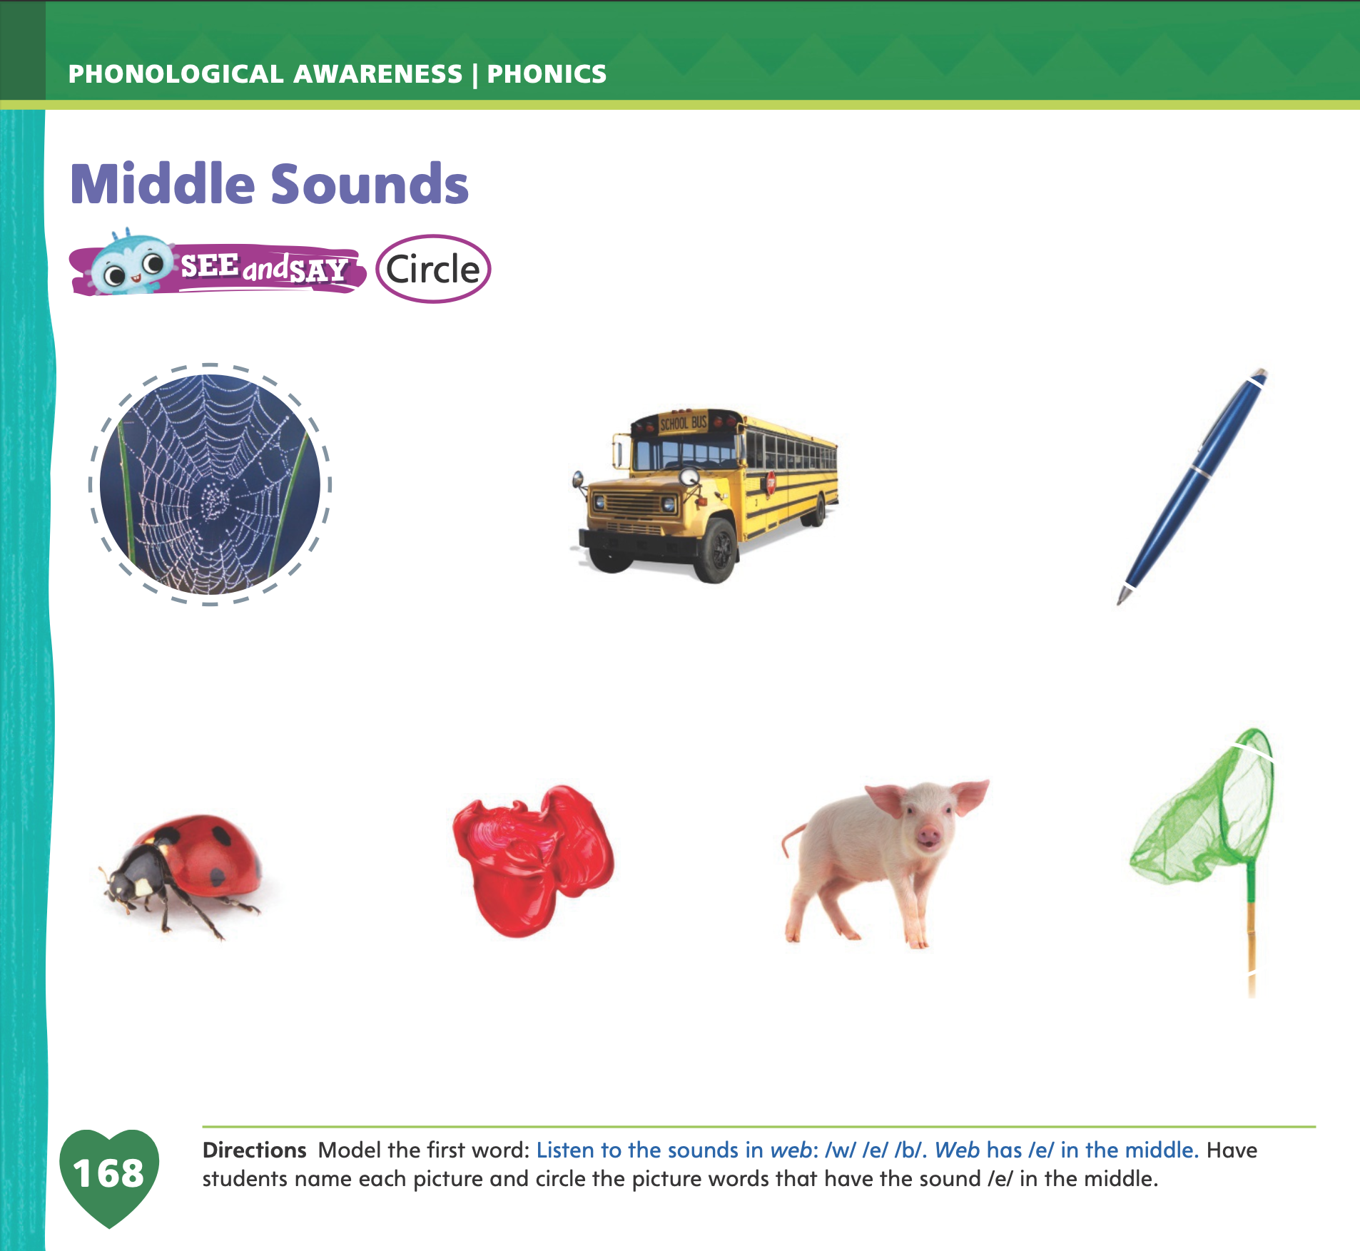
Page 168
Phonological Awareness
Turn to page 168 in your Student Interactive.
Notes:
Today we are going to learn a new sound. Listen carefully as I say the new sound: /e/ /e/ /e/. The sound /e/ is made by opening your mouth, and placing the tip of your tongue behind your bottom teeth. Show students how to say the sound /e/, and have them practice it. Try saying the sound /e/ several times. Repeat these words after me: pet, met, set, get, bet, let, net.
Have students turn to p. 168 in the Student Interactive. Tell them that they will be circling the picture words that have the sound /e/ in the middle. Listen to the sounds as I say this word: /w/ /e/ /b/, web. Say the sounds in the word with me: /w/ /e/ /b/. Repeat the word, emphasizing the medial sound: /w/ /e/ /e/ /e/ /b/. The word web has the sound /e/ in the middle, so we will circle the picture.
Name each picture on p. 168 and have students circle the picture words with the middle sound /e/.

Slide 5


Phonics
Notes:
Click path -> Table of Contents -> Unit 2 Week 5 Persuasive Text-> Lesson 2
Hold up the bed Picture Card and point to the picture of the bed. Have students say bed with you. Let’s say the sound in the middle of the word bed: /e/. The middle sound /e/ is spelled with the letter e. Show students the Alphabet Card for Ee.
Point to the letters Ee and tell students the names of these letters are uppercase E and lowercase e. Tell students the word bed has the middle sound /e/, so it has the letter e in the middle.
Write the letters E and e on the board.

Slide 6
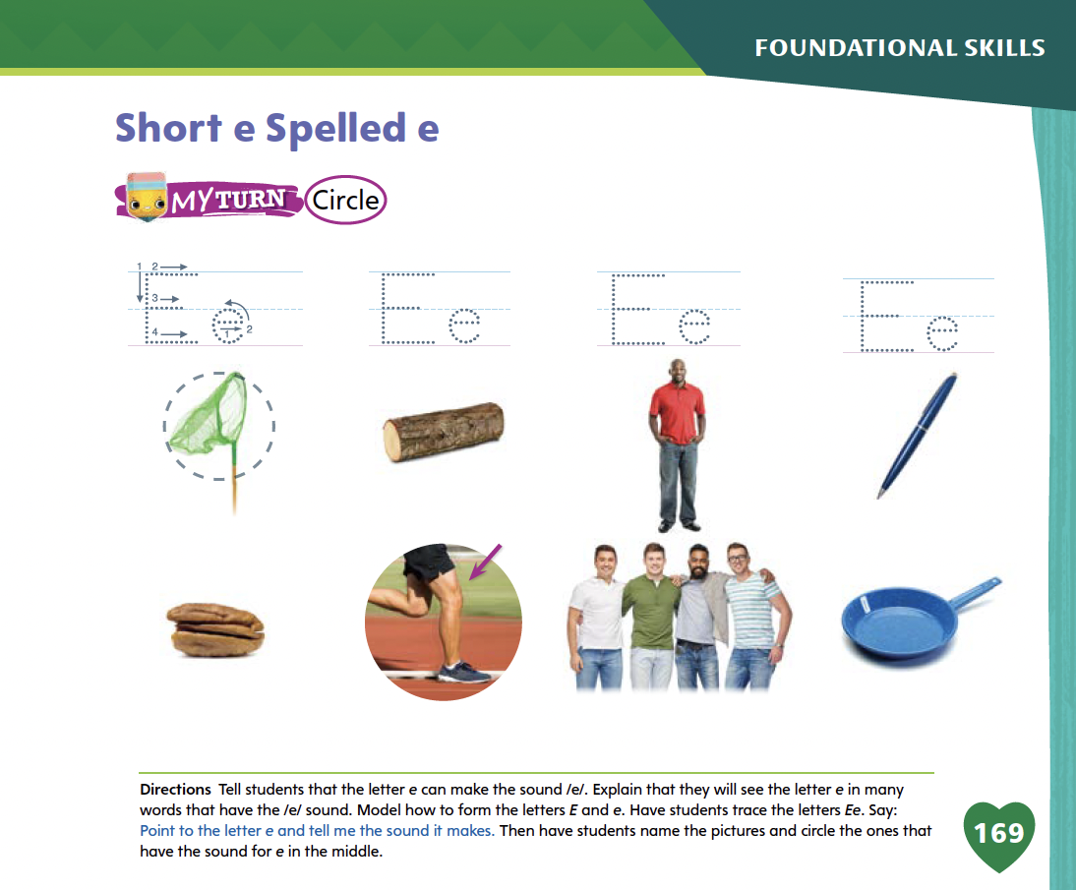
Page 169
Apply
Turn to page 169
in your Student Interactive and complete the activity.
Notes:
Have students turn to p. 169 in the Student Interactive and trace the letters on the first line with their finger. Tell students they will circle the picture words that have the sound for e in the middle. Have students point to the first picture. Say the sounds in the word net with me: /n/ /e/ /t/. Does net have the sound /e/? Yes, it does, so we will circle the picture.
Name the rest of the picture words on the page with students and have them complete the activity to identify and match the sound /e/ with the letters Ee.

Slide 7
High-Frequency Words
go
from
yellow
Notes:
Display the high-frequency words go, from, and yellow.
Point to the word go and read it.
Have students point to the word go and read it.
Repeat for from and yellow.

Slide 8
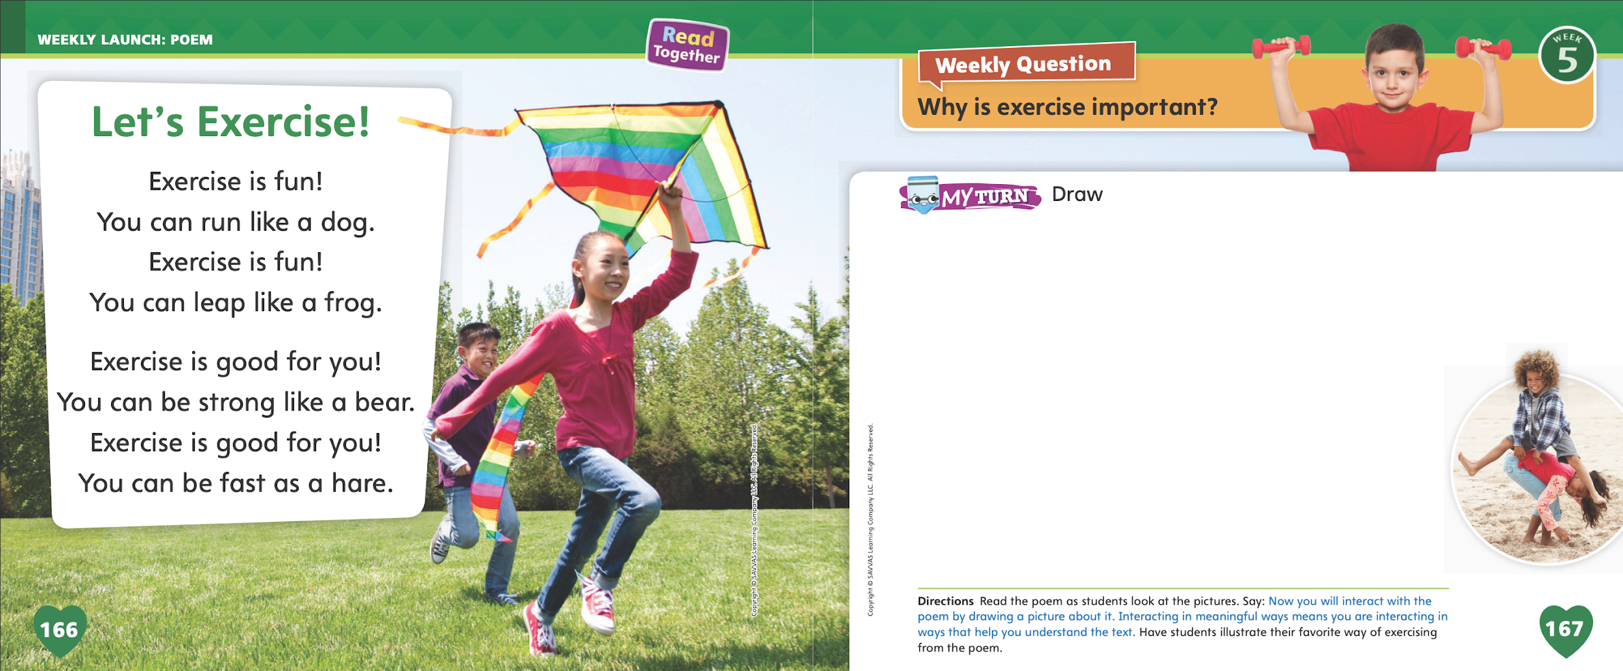
Page 166, 167
Interact with Sources
Essential Question: What do living things need?
Weekly Question: Why is exercise important?
Notes:
Remind students of the Essential Question for Unit 2: What do living things need? Point out the Week 5 Question: Why is exercise important? Explain that students will learn about exercise this week.
Have students follow along as you turn to p. 166 in the Student Interactive and point to the picture of the girl running with the kite. Explain that people need exercise. Tell students that exercise keeps us healthy. Then read the poem, “Let's Exercise!”
Tell students they can interact with poems or other sources by discussing the text, illustrating a response to the text, or writing a response to the text.
Ask students if they can picture any of the concepts from the poem, such as running, leaping, or being strong. Have them illustrate one of these actions. Then ask them if they can picture what any of the animals in the poem do.
Ask for volunteers to safely act out some of the forms of exercise mentioned in the poem.
Ask students to think about whether or not they think it is good to exercise. Then have them create a written response for why it is good to exercise.
TURN, TALK, AND SHARE: After discussing the poem, have students interact with the poem by completing the drawing activity on p. 167 in the Student Interactive.
Point out the Week 5 Question: Why is exercise important? Tell students that they just read a poem that talked about exercise. Remind them that the poem gave some reasons that exercise is good or beneficial. Tell them that they will read other texts this week about the importance of exercise. The texts they read this week will try to persuade them that exercise is good.

Slide 9
Listening Comprehension
Why People Should Exercise
won’t get sick
Notes:
Tell students that some texts are meant to persuade, or lead, someone to think or do something. SAY: For example, an author might write a text to tell people they should eat healthy food. In “Time to Move!” the author wants people to know why it is important to exercise. Ask students to listen actively by looking at you and thinking about the ideas in the text as you read.
Purpose: Have students listen actively for characteristic features of persuasive text, such as an opinion and supporting reasons.
READ: the entire text aloud without stopping for the Think Aloud callouts.
REREAD: the text aloud, pausing to model Think Aloud strategies related to the genre.
Use the chart to show reasons that the author gives for exercising.

Slide 10
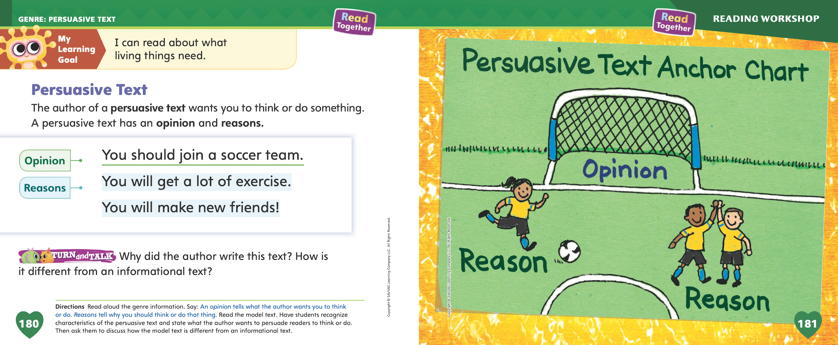
Page 180
Persuasive Text
Turn to page 180 in your Student Interactive.
Notes:
Tell students that persuasive texts are written in order to make readers think or do something.
A persuasive text often begins with an opinion that tells what the author thinks about something.
The author uses words, such as should, to help persuade, or tell, readers to think the same way.
The author gives reasons that others should think the same way. Reasons are facts and ideas that support an opinion.
Readers can look for the opinion and reasons in a persuasive text. Identifying these parts of the text makes it easier to understand.
Remind students that you just read “Time to Move!” Tell them that because this text is a persuasive text, it has an opinion and supporting reasons.
The author says that exercise is the “best thing ever.” The author wants us to think this, too.
The author tells us reasons that exercise is the best thing ever. The author says that exercise helps us be healthy and is a way to make friends.
Read aloud the text on p. 180 of the Student Interactive. Point out the opinion and reasons. Editable Anchor Chart Click Path: Table of Contents -> Reading Anchor Charts -> Unit 2 Week 5: Persuasive Text Reading Anchor Chart

Slide 11
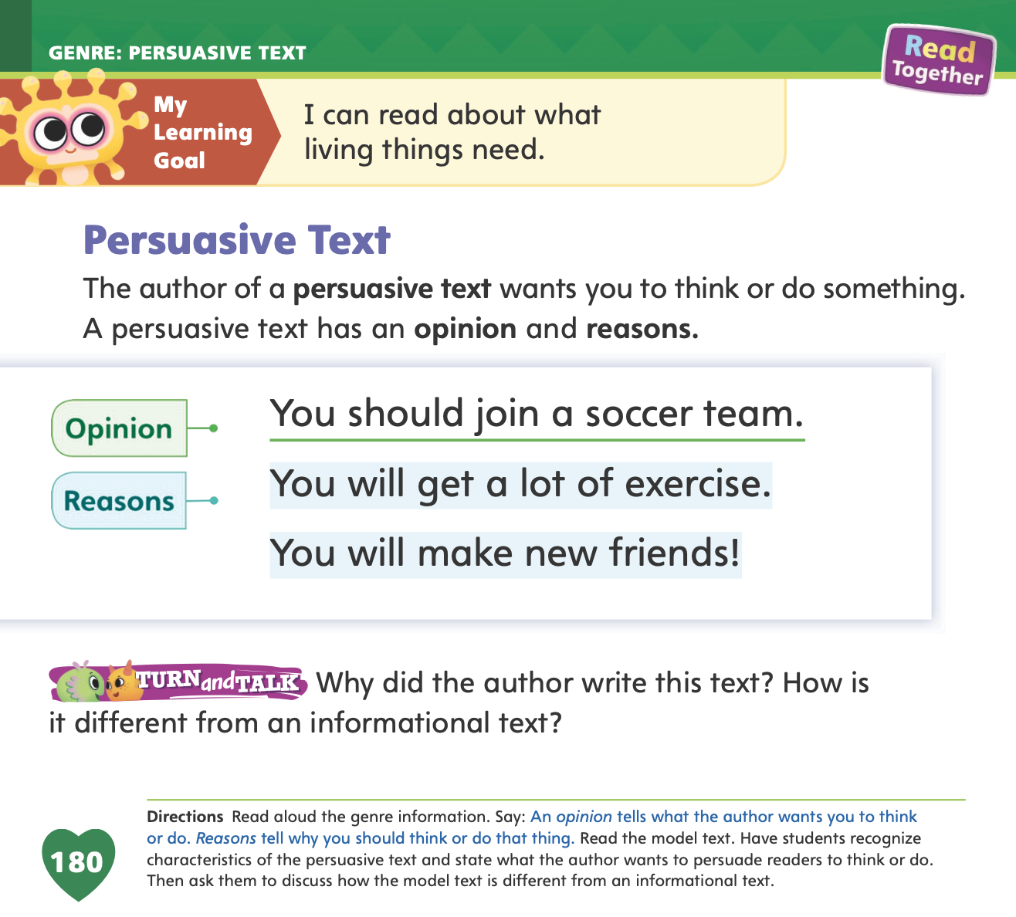

Page 180
Apply
Discuss how a persuasive text is different from an informational text with a partner.
Notes:
Have students discuss how a persuasive text is different from an informational text.

Slide 12
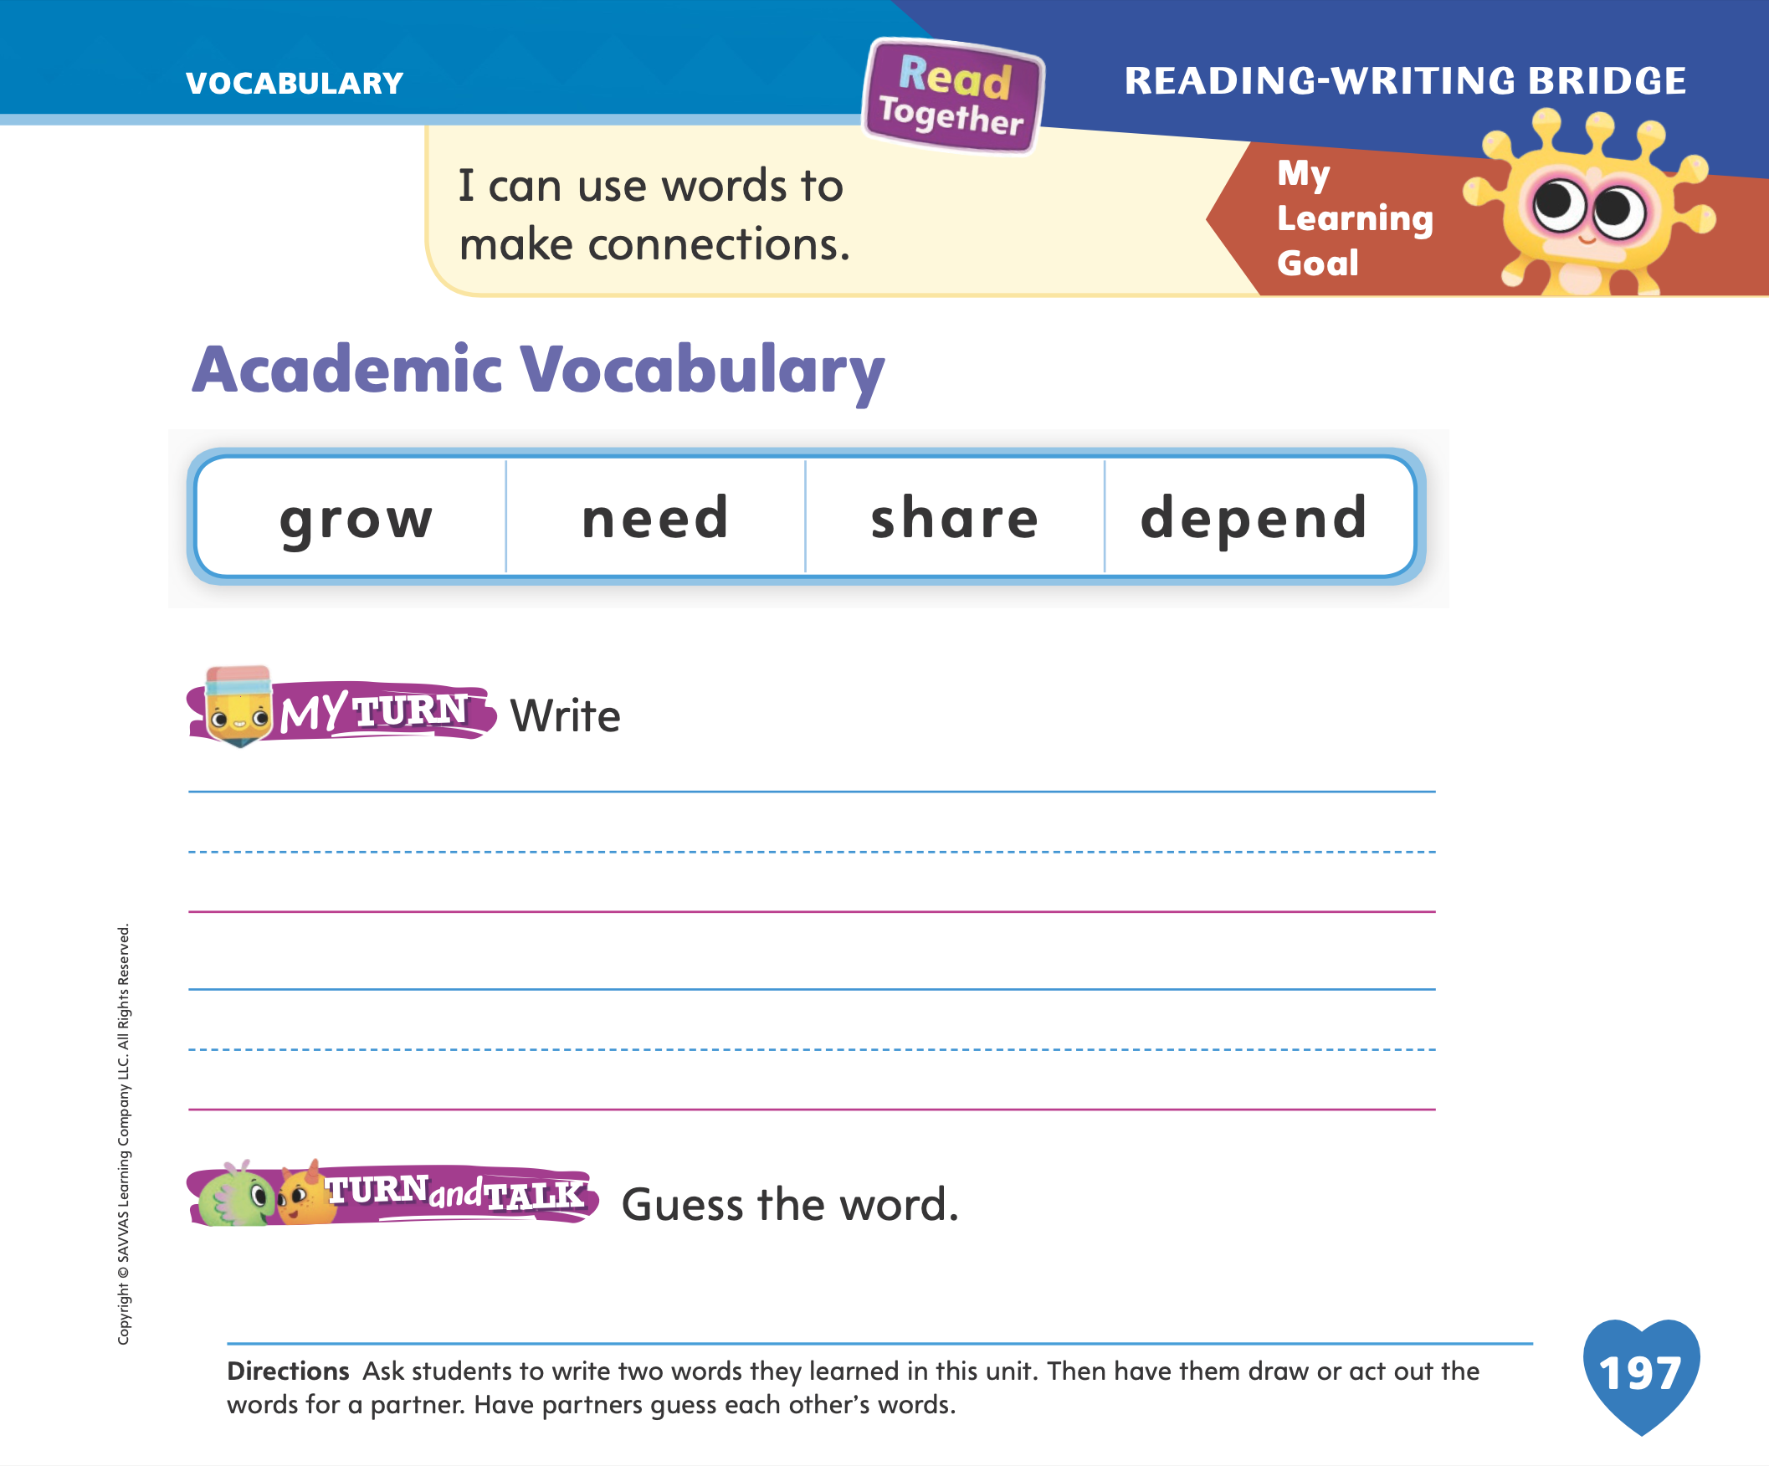
Page 197
Academic Vocabulary
Turn to page 197 in your Student Interactive and complete the activity.
Notes:
Explain to students that they can develop their vocabulary by using new words orally when speaking with others.
Using vocabulary words when talking with and having fun with others can help you learn more about what the words mean.
If you don’t know how to say what a word means, you can act out or show its meaning.
Have students turn to p. 197 in the Student Interactive. Model how you act out the word grow and then how you draw it. Give partners one of the words and ask them to talk about how they could draw or act out the word’s meaning. Tell them they will present their word to the class.
Have students find partners and complete the oral language activity on p. 197 in the Student Interactive. Then have students share their drawings or performances with the class.

Slide 13
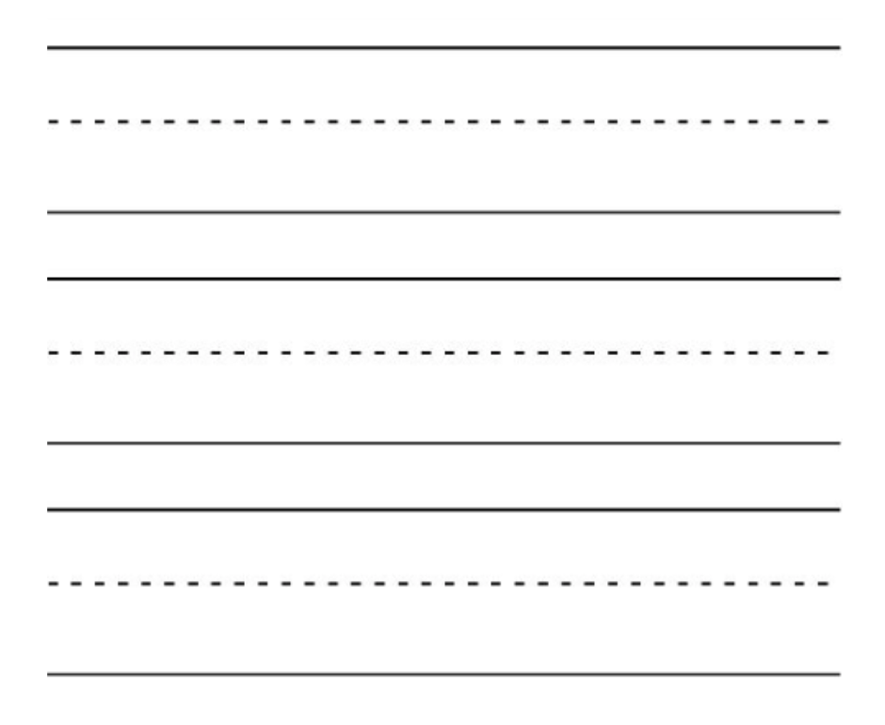
Handwriting
bed
from
Notes:
Write the words bed and from on the board. Explain to students that you are writing whole words by writing groups of letters together. Ask for volunteers to read the words to the class. Identify the two words with the whole class.
Point to the word bed. Say: This is the word bed. Bed has three letters in it: b, e, d. Practice writing these three letters in order to make the word bed. Have students practice tracing the word bed on their desks with a finger. Then repeat the exercise for the word from.
Write the words red and go on the board. Ask students if they can identify the words. Say: These are the words red and go. Let’s practice writing these words. Have students practice tracing the words red and go on their desks.
Have students use Handwriting p. 84 from the Resource Download Center to practice writing words. Click path: Realize -> Table of Contents -> Resource Download Center -> Handwriting Practice -> U2W5L1 Handwriting Practice

Slide 14
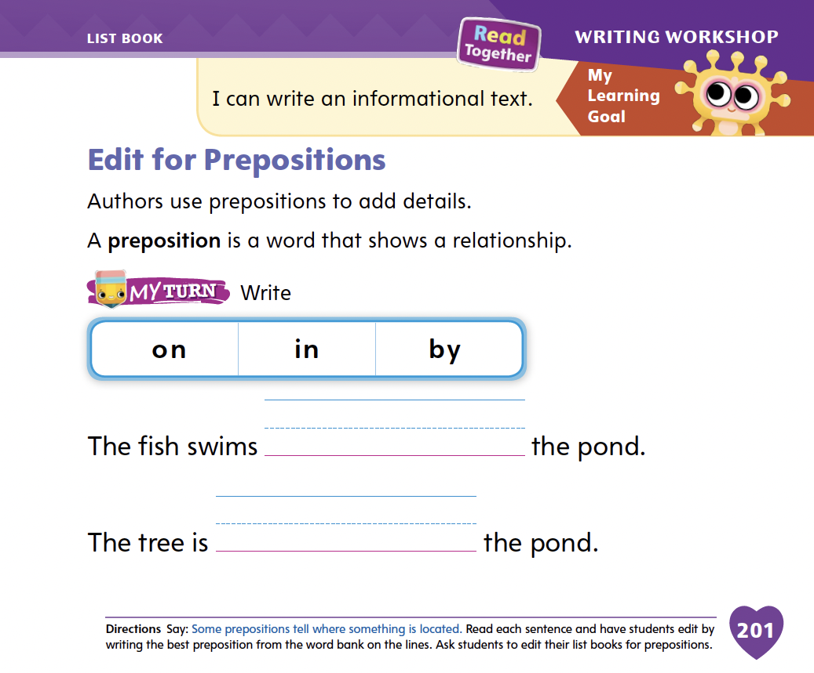
Page 201
Writing – List Book
Turn to page 201 in your Student Interactive and complete the activity.
Notes:
Prepositions are used to add details to a text. Prepositions are words that show where something is located. Examples include in, on, near, under, by, and over.
Tell students you will play a riddle game. You will give students clues and they will guess the item using your clues. Look around the classroom and find items that are over, under, in, by, near, or on something. Use adjectives in your sentences to give students additional practice in using describing words. For example: This round item is over the door. Or, This small, green object is on my desk. As you give clues, emphasize the prepositions.
Next, write the following prepositions on a flipchart or board: in, on, near, under, by, and over. These are prepositions. They add details to sentences and tell the location of something. Write: The book is on the desk. Read the sentence aloud. We are going to edit this sentence together. When I move the book, tell me how I should edit the sentence. Place a book under a desk. I know that the book is not on the desk. I will cross out that word. What word should I use instead? Have students supply the word under, and repeat the activity, moving the book to other locations.
Have students edit for prepositions on p. 201 in the Student Interactive.

Slide 15

Independent Writing
Review and edit your book for prepositions.
Notes:
Tell students that they will present their list book later this week. Today they should choose the book they would like to present. They will spend a few days editing it and preparing it for presentation.
Have them spend independent writing time reviewing and editing their book for prepositions.
Modeled Write sentences on a board or flipchart, using prepositions.
Shared As students write, encourage them to vary the prepositions and adjectives used.
Guided Guide students to use prepositions and adjectives as they write.
As students write, use the conference prompts in the Teacher’s Edition or Resource Download Center to provide support. Click path: Table of Contents -> Resource Download Center -> Writing Workshop Conference Notes
Call on students to share prepositions they used in their book.

Slide 16
Language and Conventions
  I jump.
  I jumped.
  I jumped yesterday.
Practice using past-tense verbs in sentences with a partner.
Notes:
Tell students that verbs are words that name actions, or things people do. Past-tense verbs are verbs that name or describe things people have done in the past.
Model for students. Tell them that the sentence I jump is about jumping right now, whereas the sentence I jumped is about jumping in the past. Expand on the example by telling students the sentence I jumped yesterday.
Have students practice using past-tense verbs by finding partners and taking turns forming sentences with past-tense verbs.

Slide 17
Lesson 2

Slide 18


Phonics
Ee
Oo
Notes:
Hold up the desk Picture Card. This is a picture of a desk. Listen to the sounds in the word desk: /d/ /e/ /sk/. I hear the sound /e/ in the middle of desk. Say /e/ with me. Click path -> Table of Contents -> Unit 2 Week 5 Persuasive Text-> Lesson 2
Turn the card over and show students the spelling of the word. Point to the e and say /e/. Do you hear the sound /e/? What letter makes the sound /e/? Have students identify the letter e. Write the letters Ee and Oo on the board. Review the sound for the letter o with students. Then divide students into two teams. The first team is short e. The second team is short o. Write the following words on the board: egg, leg, log, pet, mop. Read the words aloud. When a word with the sound /e/ is said, the short e team stands up. When a word with the sound /o/ is said, the short o team stands up.
Point to the letters Ee on the board. Then display the word get. Listen carefully to the following word: /g/ /e/ /t/. Do you hear the sound /e/ in this word? What letter spells the sound /e/ in get? Have a volunteer point to the letter e in the word.

Slide 19
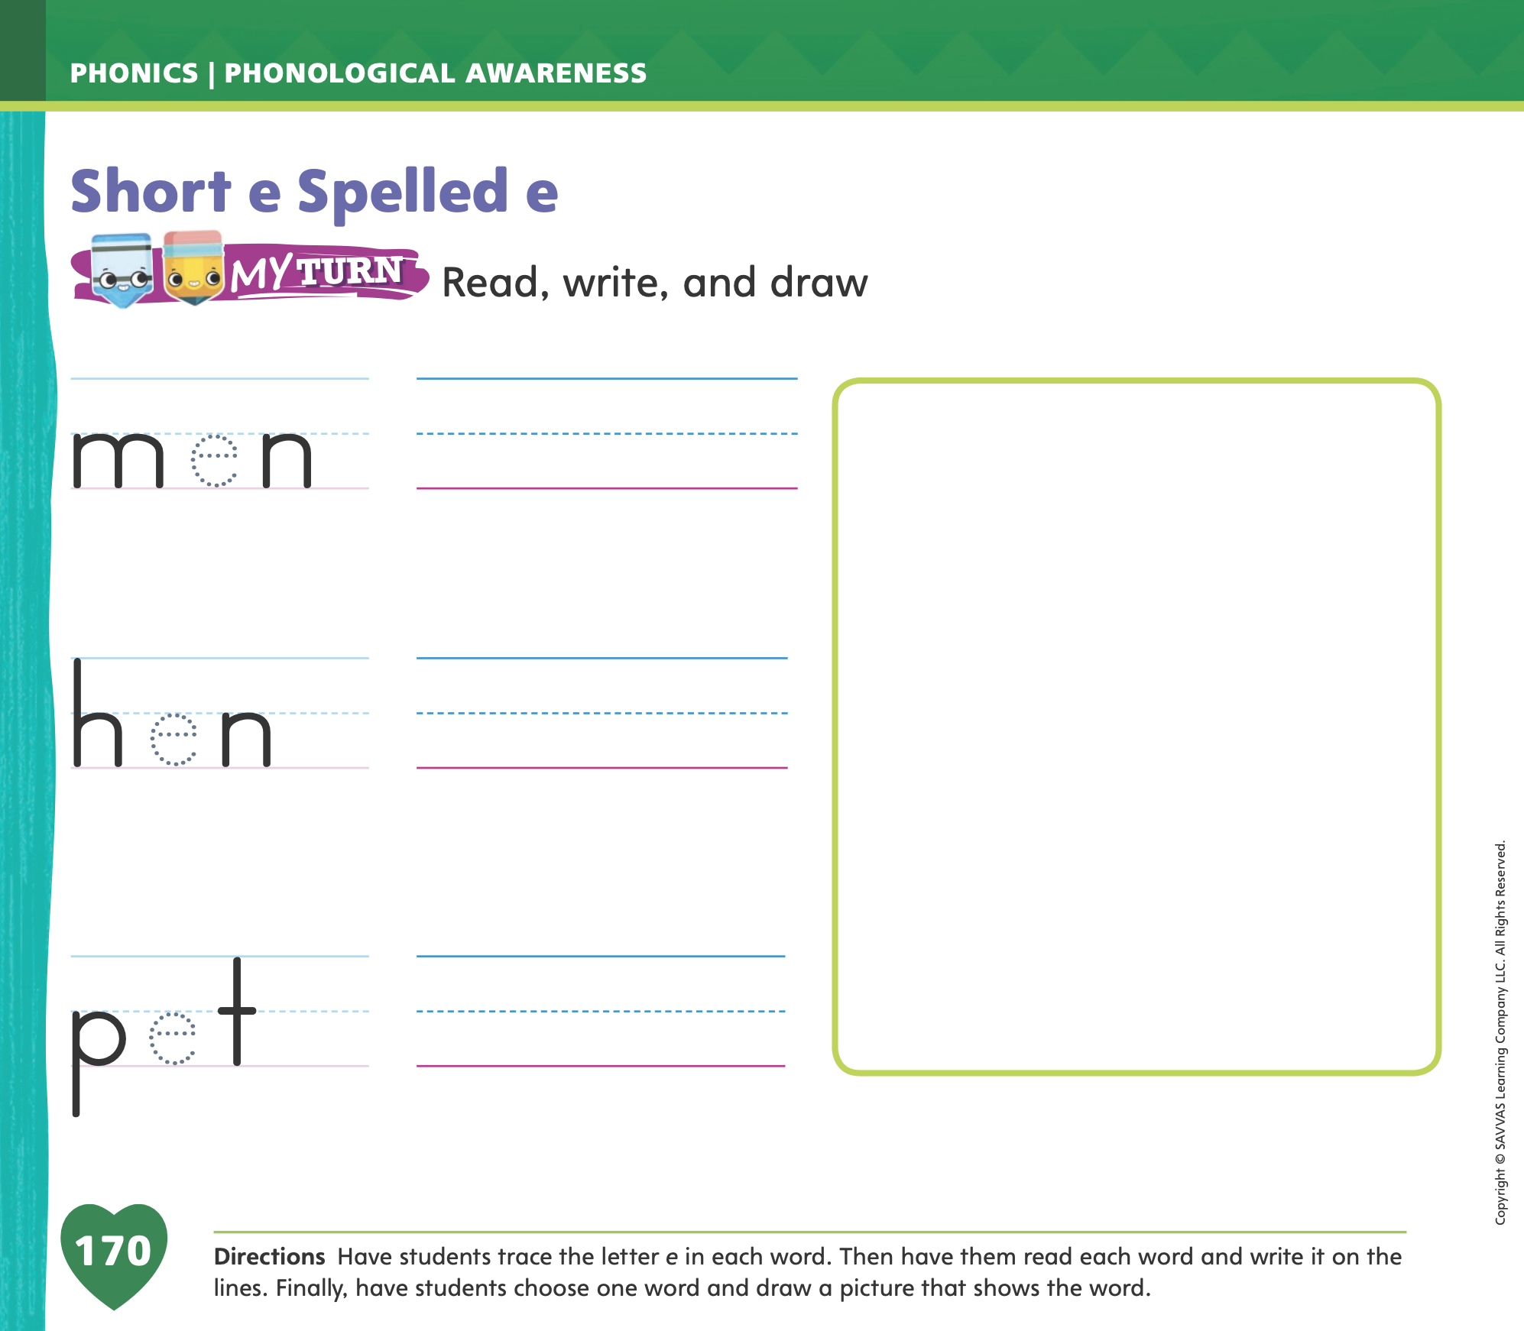
Page 170
Apply
Turn to page 170 in your Student Interactive and complete the activity.
Notes:
Have students complete the rest of p. 170 in the Student Interactive.

Slide 20
High-Frequency Words
go
from
yellow
Notes:
Tell students that high-frequency words are words they will hear and see over and over in texts. Write and read the words go, from, and yellow.
Have students
read each word.
spell each word, clapping as they say each letter.

Slide 21
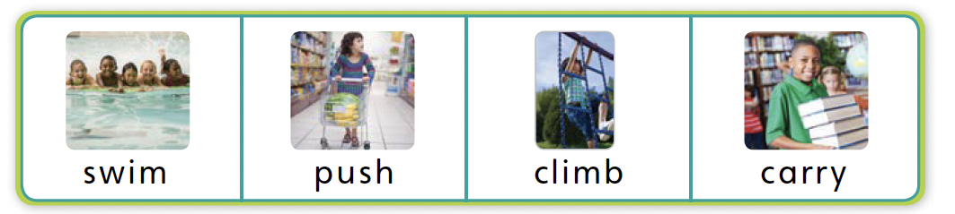
Page 182
Preview Vocabulary
Notes:
Tell students you are going to teach them some new words. Say the words push, swim, climb, and carry.
Prompt students to look at the pictures of these words on p. 182 in the Student Interactive.
Have students say what they already know about each of the words. Provide prompts. What is something you push? What animals swim? What can you climb? What do you carry to school?
Tell students to watch for these words in Run, Jump, and Swim.

Slide 22

Page 183
Print Awareness
Notes:
Have students look at p. 183 in their Student Interactive. Guide students to recognize the difference between a letter and a printed word. Point to the first letter on the page. This is a letter. Run your finger under the first word. This is a word.
Ask volunteers to find another word on the page. Ask them to tell a letter in the word.

Slide 23
Page 183
First Read – Run, Jump, and Swim
Notes:
Discuss the First Read Strategies. In this first read, ask students to think about what the author wants them to know. After students complete the First Read, ask: What did you learn? What surprised you?
READ Read or listen to the text.
LOOK Look at the pictures to help understand the text.
ASK Generate, or ask, questions about the text to deepen understanding.
TALK Talk to a partner about the text.
Help students to read the whole text independently, in pairs, or as a whole class. Use the First Read notes to help students connect with the text and to monitor comprehension.

Slide 24


Page 184, 185
First Read – Run, Jump, and Swim
Notes:
Read together.
THINK ALOUD I read the word exercise, but I don't know what it means. What can I do? I am going to reread the text to find out. The text says: "It gives you strength to carry things." I can look at the photographs on these pages to clarify the meaning of exercise. In the pictures on pages 184 and 185, I see a girl with a hula hoop and a boy carrying books. Now that I have reread the sentences and looked at the pictures, I think exercise means moving around and doing things to stay strong.

Slide 25
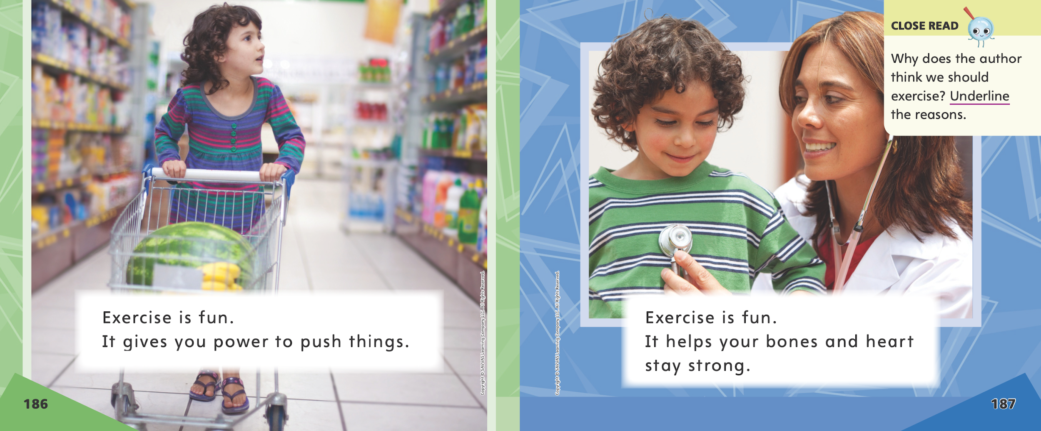
Page 186, 187
First Read – Run, Jump, and Swim
Notes:
Read together.

Slide 26

Page 188, 189
First Read – Run, Jump, and Swim
Notes:
Read together.
THINK ALOUD Let’s look at the photos on page 188. In one of the photos, children are running. In the other photo, a child is climbing. I think the author wanted to include these photos because they help make a connection to the text "You can run." and "You can climb." The pictures help me understand what I am reading. Look at the pictures on page 189. What do you think the sentences on this page will be about?

Slide 27
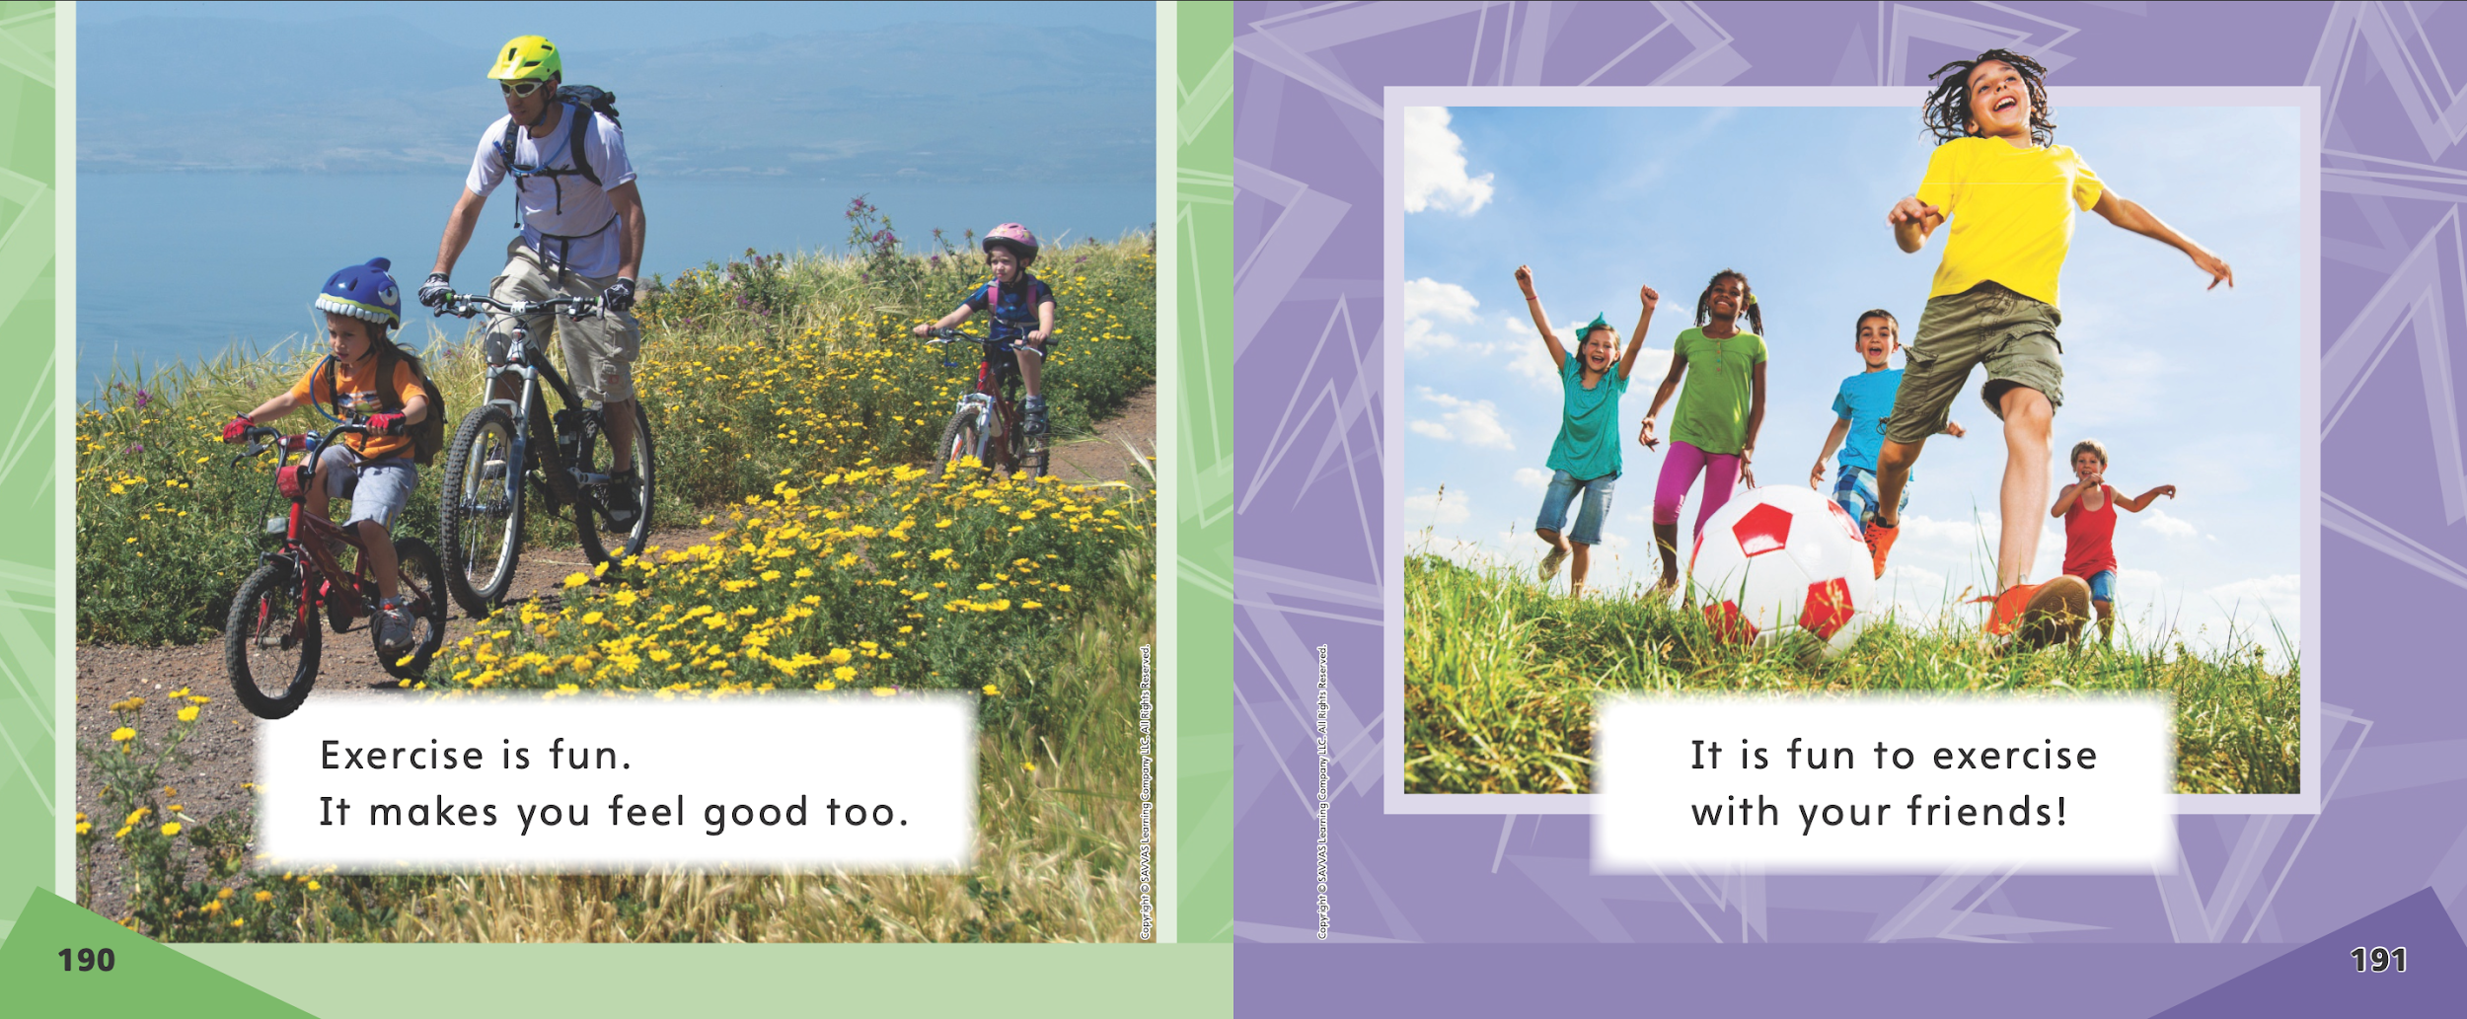
Page 190, 191
First Read – Run, Jump, and Swim
Notes:
Read together.

Slide 28
Respond and Analyze
Author’s Claim: Ask students if the author persuaded them or not.
Author’s Reasons: If students agree with the author, ask them why.
Notes:
Ask students how they feel about exercise now that they have read the story Run, Jump, and Swim.
Author’s Claim: Ask students if the author persuaded them or not. Say: The author of the story says we should exercise. Do you agree or not? Tell me why.
Author’s Reasons: If students agree with the author, ask them why. Encourage them to find evidence in the text. If students disagree with the author, ask them to provide reasons of their own.

Slide 29
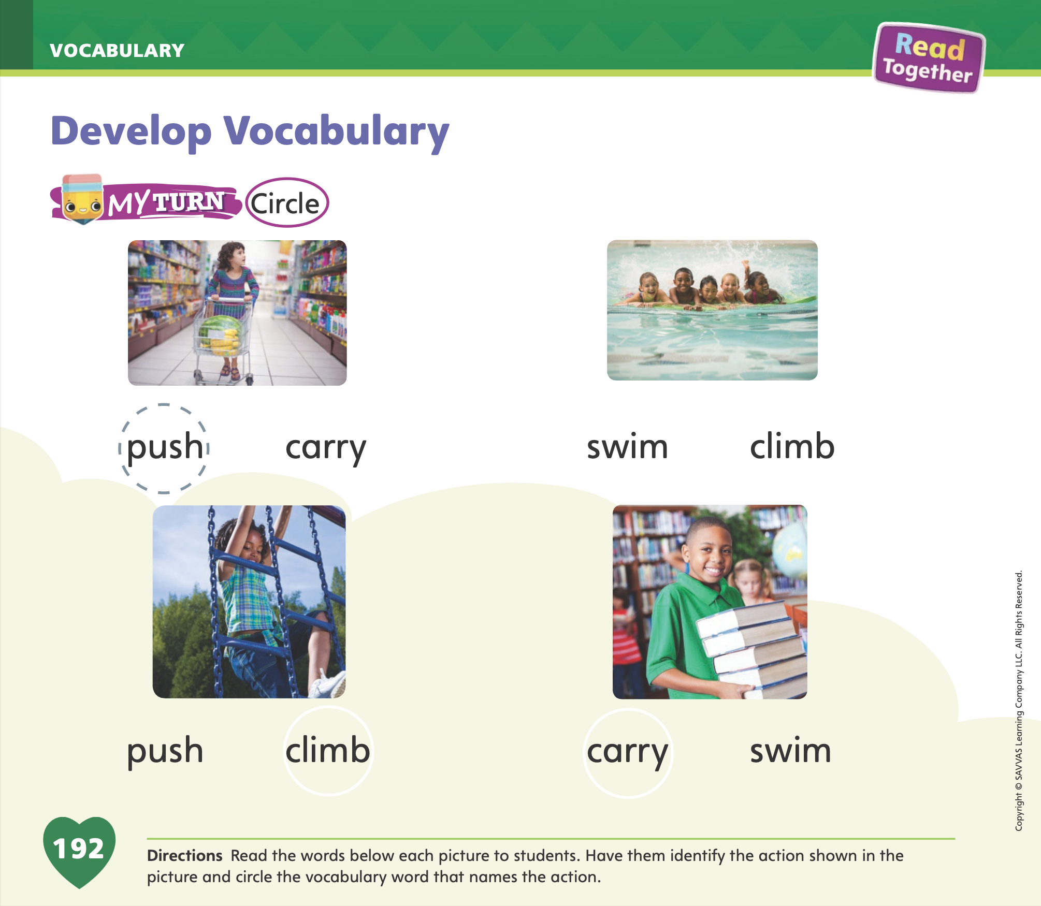
Page 192
Develop Vocabulary
Turn to page 192 in your Student Interactive and complete the activity.
Notes:
Explain to students that they can use pictures to help understand what words mean.
READ Read the four vocabulary words: push, carry, swim, climb.
THINK What do these words mean? Call on volunteers to attempt to act out the words.
PICTURE Try to picture each word. What would each word look like?
Have students look at the picture of a child pushing a shopping cart on p. 192 in the Student Interactive. Explain to students
that the word shown in the image is push. Tell them that they can clarify the meanings of words by looking at pictures.

Slide 30
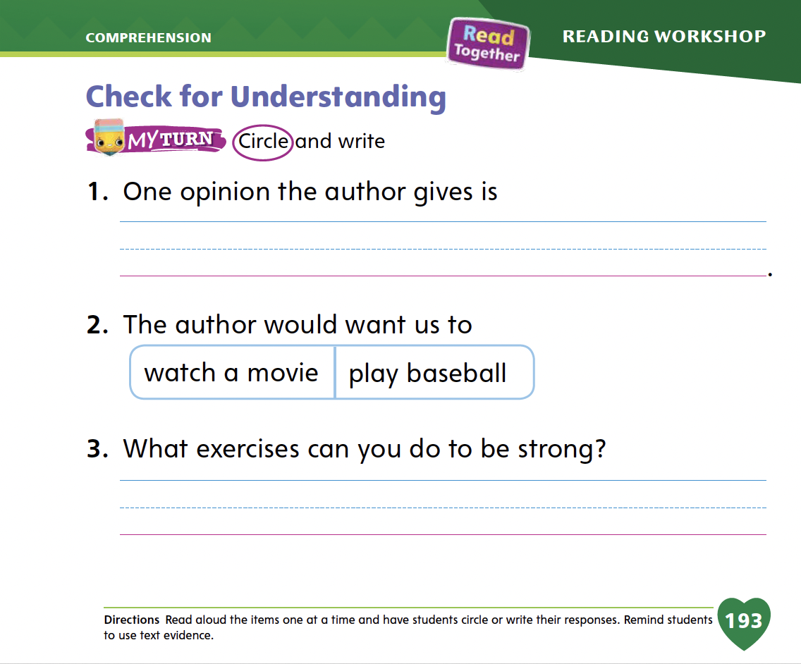
Page 193
Check for Understanding
Turn to page 193 in your Student Interactive and complete the activity.
Notes:
Have students complete the Check for Understanding on p. 193 in the Student Interactive.

Slide 31
Writing – List Book
  read this book!
  The boy took a walk.
  how was your day?
  i like sports.
  look at the tree.
Notes:
A sentence begins with a capital letter. Authors go back and edit their books to make sure they have capitalized the first word in each sentence.
Tell students that good writers go back and revise their work to make sure they have capitalized all the correct words in their book. Ask students to explain when words are capitalized. (The first letter in a word is capitalized at the beginning of a sentence.) Write a few simple sentences for the class to see, making sure to include a few examples of sentences with correct capitalization, and many examples of sentences that are not capitalized at the beginning. Example sentences include:
read this book!
The boy took a walk.
how was your day?
i like sports.
look at the tree.
Then tell students you will use your good writing skills to go back and revise the sentences. Think aloud as you look for the word that should be capitalized in the first sentence. Say: I know that the first word in a sentence should be capitalized. What is the first word in this sentence? That’s right, the first word is read. What is the first letter in read? That’s right, the letter r. Since this is a complete sentence, I know that the letter r should be capitalized. I need to edit this sentence. I will circle the r, and I will write a capital R above it. Continue with the other sentences.
Have students edit for capitalization on p. 202 of the Student Interactive.

Slide 32
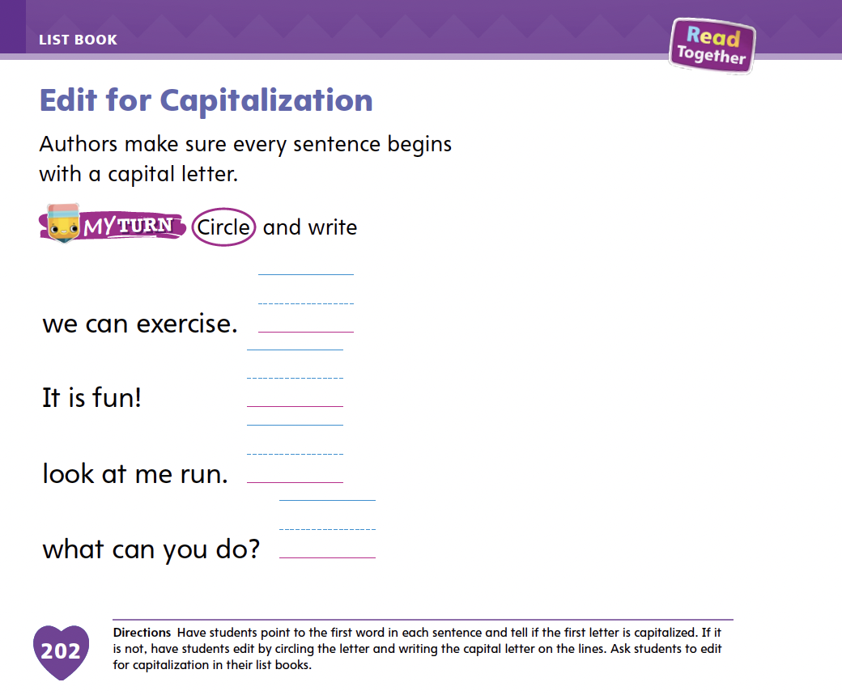
Page 202
Writing – List Book
Turn to page 202 in your Student Interactive and complete the activity.
Notes:
Have students edit for capitalization on p. 202 of the Student Interactive.

Slide 33
Independent Writing
Review and edit both the text and pictures in your list book for capitalization.
Notes:
Have students review their list books and edit for capitalization.
Then, tell students to edit both the text and the pictures in their list books.
Modeled Go back to the student’s writing and model editing words for capitalization.
Shared Have students identify capitals used in each other’s writing.
Guided Use a stack text to provide explicit instruction about capitalizing the first letter in words.
As students write, use the conference prompts in the Teacher’s Edition or Resource Download Center to provide support. Click path: Table of Contents -> Resource Download Center -> Writing Workshop Conference Notes
Call on a few students to show their work to the class. Prompt students to explain what words they capitalized and why.

Slide 34

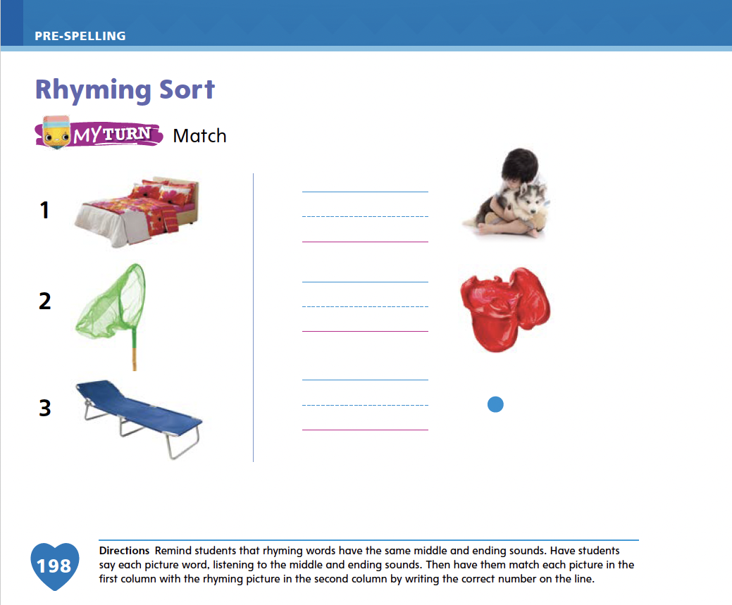
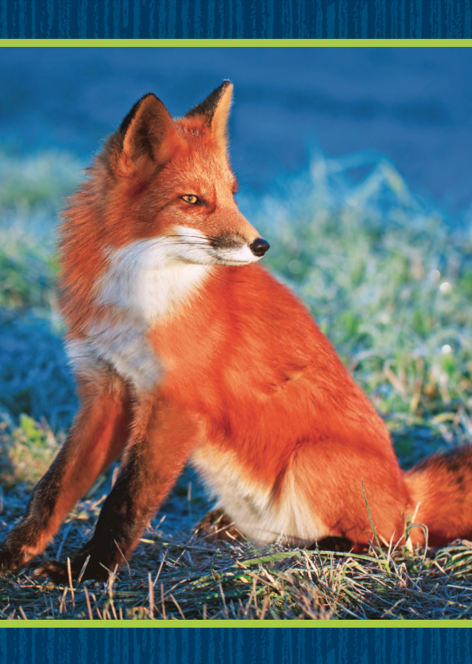
Page 198
Rhyming Sort
Turn to page 198 in your Student Interactive and complete the activity.
Notes:
Tell students that rhyming words have the same middle and ending sounds but have different beginning sounds. Display the box and fox Picture Cards. Have students identify the words represented by the pictures. Tell students that box and fox are rhyming words. Have students identify the initial and ending sounds in box. Listen to the word box. What is the first sound in box? That’s right, /b/ is the first sound in box. How does box end? That’s right, box ends with the sound /o/ /ks/. Continue with the word fox. Click path -> Table of Contents -> Unit 2 Week 5 Persuasive Text-> Lesson 2
Ask students what makes box and fox rhyming words. Guide them to conclude that the words rhyme because they share an ending sound but have different beginning sounds. Have students open to p. 198 in the Student Interactive. This is a bed. Bed rhymes with red, so I will write the number from bed next to the word red. Have students write the number 1 next to the word red.
Have students complete the other items on p. 198. Provide support as needed, and assist them in checking whether or not words rhyme.

Slide 35
Language and Conventions
  I will do my work.
  I will go to the store tomorrow.
Practice saying sentences using future-tense verbs.
Notes:
Tell students that future-tense verbs name or describe things people are going to do in the future.
Model using future verbs for students. Say: I will do my work. I will go to the store tomorrow. These sentences use future-tense verbs. Will do and will go are future verbs. If a verb is in the future tense, it has the word will before it. Model additional examples for students if needed.
Have students practice using future-tense verbs by using oral language strategies. Call on one or two students and ask each student to say a sentence using a future-tense verb to the class.

Slide 36
Lesson 3

Slide 37

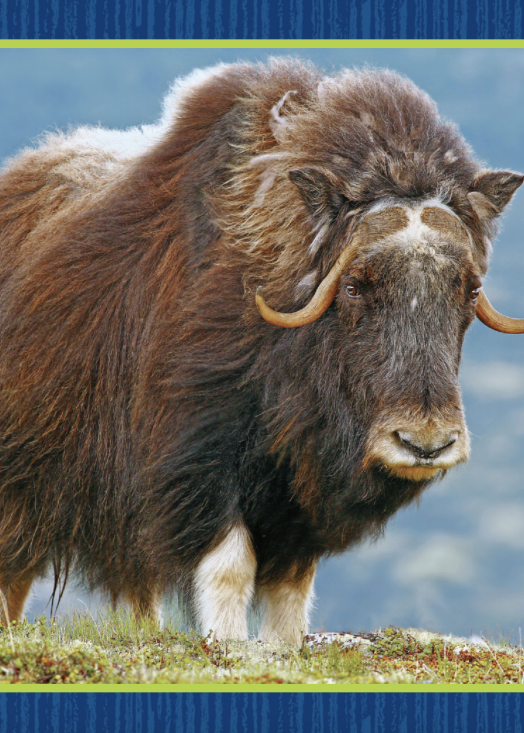
Phonological Awareness
Notes:
Today we are going to learn two new sounds. Listen carefully: /w/ /w/ /w/. The sound /w/ is made by making a tight circle with your lips and holding your tongue in the back of your mouth. Show students how to make the sound /w/. Repeat for the sound /y/, instructing students to place their tongue behind their lower teeth.
Display the waffle Picture Card. This is a picture of a waffle. Listen to the beginning sound as I say the word: /w/ -affle. What sound does waffle begin with? Students should say /w/. Repeat with the yak Picture Card. Click path -> Table of Contents -> Unit 2 Week 5 Persuasive Text-> Lesson 3

Slide 38
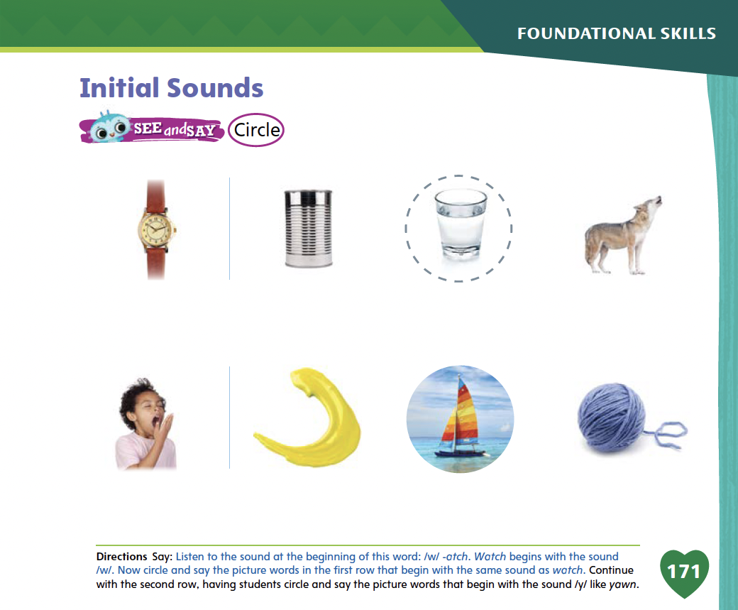
Page 171
Phonological Awareness
Turn to page 171 in your Student Interactive and complete the activity.
Notes:
Have students point to the picture of the watch on p. 171 of the Student Interactive. Listen to the sounds in this word: /w/ -atch. Watch has the sound /w/ at the beginning. Circle the picture words in the first row that begin with the same sound as watch. Then have students repeat the activity for the sound /y/ in the second row.

Slide 39


Phonics
Notes:
Display the Ww Alphabet Card. Point to the picture of the watermelon and tell students the word watermelon begins with the sound /w/. Point to the letters Ww. These letters are uppercase W and lowercase w. The letter w spells the sound /w/ at the beginning of watermelon. Repeat with the Yy Alphabet Card. Click path -> Table of Contents -> Unit 2 Week 5 Persuasive Text-> Lesson 3
Have students turn to p. 172 in the Student Interactive. Write the letters Ww and Yy on the board and have students trace the letters on the page with their fingers. Look at the picture of the butterfly wing. Listen carefully as I say the word: /w/ -ing. Does wing begin with the sound /w/ or the sound /y/? (/w/) Let's draw a line from the picture to the letters Ww. Now let's trace the letters Ww.

Slide 40
Page 172
Apply
Turn to page 172 in your Student Interactive and complete the activity.
Notes:
Have students complete the activity on p. 172.

Slide 41
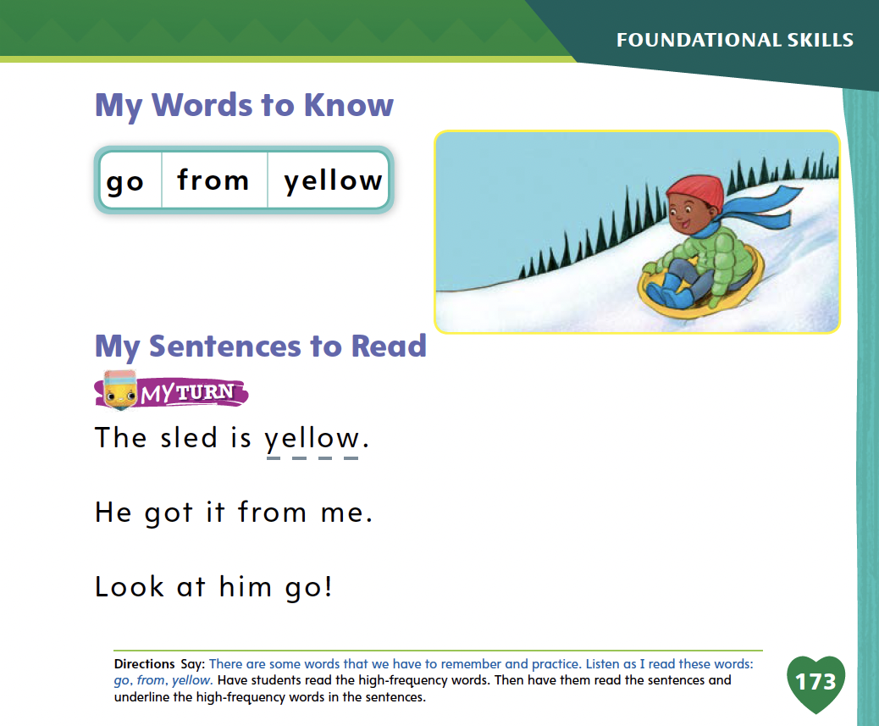
Page 173
High-Frequency Words
Turn to page 173 in your Student Interactive and complete the activity.
Notes:
Tell students that today they are going to continue working with this week's high-frequency words. You will need to remember these words by sight. Have students read the words at the top of p. 173 in the Student Interactive with you: go, from, yellow.
Have students look at the words at the top of p. 173. Tell them to identify and point to each word when you say it. Say go. Pause to let students find and point to the word. Say from. Say yellow. Repeat the activity until students are familiar with each word. Then have students use the words in sentences.
Have students read the sentences on p. 173 with you. Ask them to identify the words go, from, and yellow in the sentences. Have them underline the high-frequency words in the sentences. Then have them read the sentences with a partner.

Slide 42
Page 145
Find Text Features
Notes:
Remind students that persuasive texts are texts that claim that readers should think or do something. Authors use text structure to organize their opinions and then give reasons, or evidence, to support their claims. These are important parts in persuasive texts.
Remind students to:
look for words such as better or great that the author uses to convince readers.
recognize words that call on readers to agree, such as should or must.
look for evidence before “buying in” to the author’s claim. Ask: Why should I do that? Why should I think that? An author’s reasons or evidence answer these why questions.
Readers can learn to identify the text structures that characterize persuasive texts. Doing this will help readers to weigh the information and think of how to respond.
Remind students about the selection Run, Jump, and Swim. Assist students as they think about whether or not it was a persuasive text, and how they can tell.
Look at pages 184 and 185 in the Student Interactive. Is the author trying to get us to think or do something? Notice that she uses the word should. She is trying to get us to exercise. Her claim is that we should exercise. Direct students to the Close Read note on p. 185. Have them underline what the author wants them to do.
Look at pages 186 and 187. Here the author is telling us why exercise is good. She is giving reasons, or evidence, to support her claim. Point out to students the Close Read note on p. 187 in the Student Interactive. Have them underline the reasons the author gives.

Slide 43
Page 184,185
Close Read – Find Text Structure
Turn to page 184, 185 in your Student Interactive.
Notes:
What does the author want us to do? Work with students to find and underline the word on pp. 184–185 that shows the answer. Point out that the rest of the text explains why and how readers should exercise. DOK 2

Slide 44
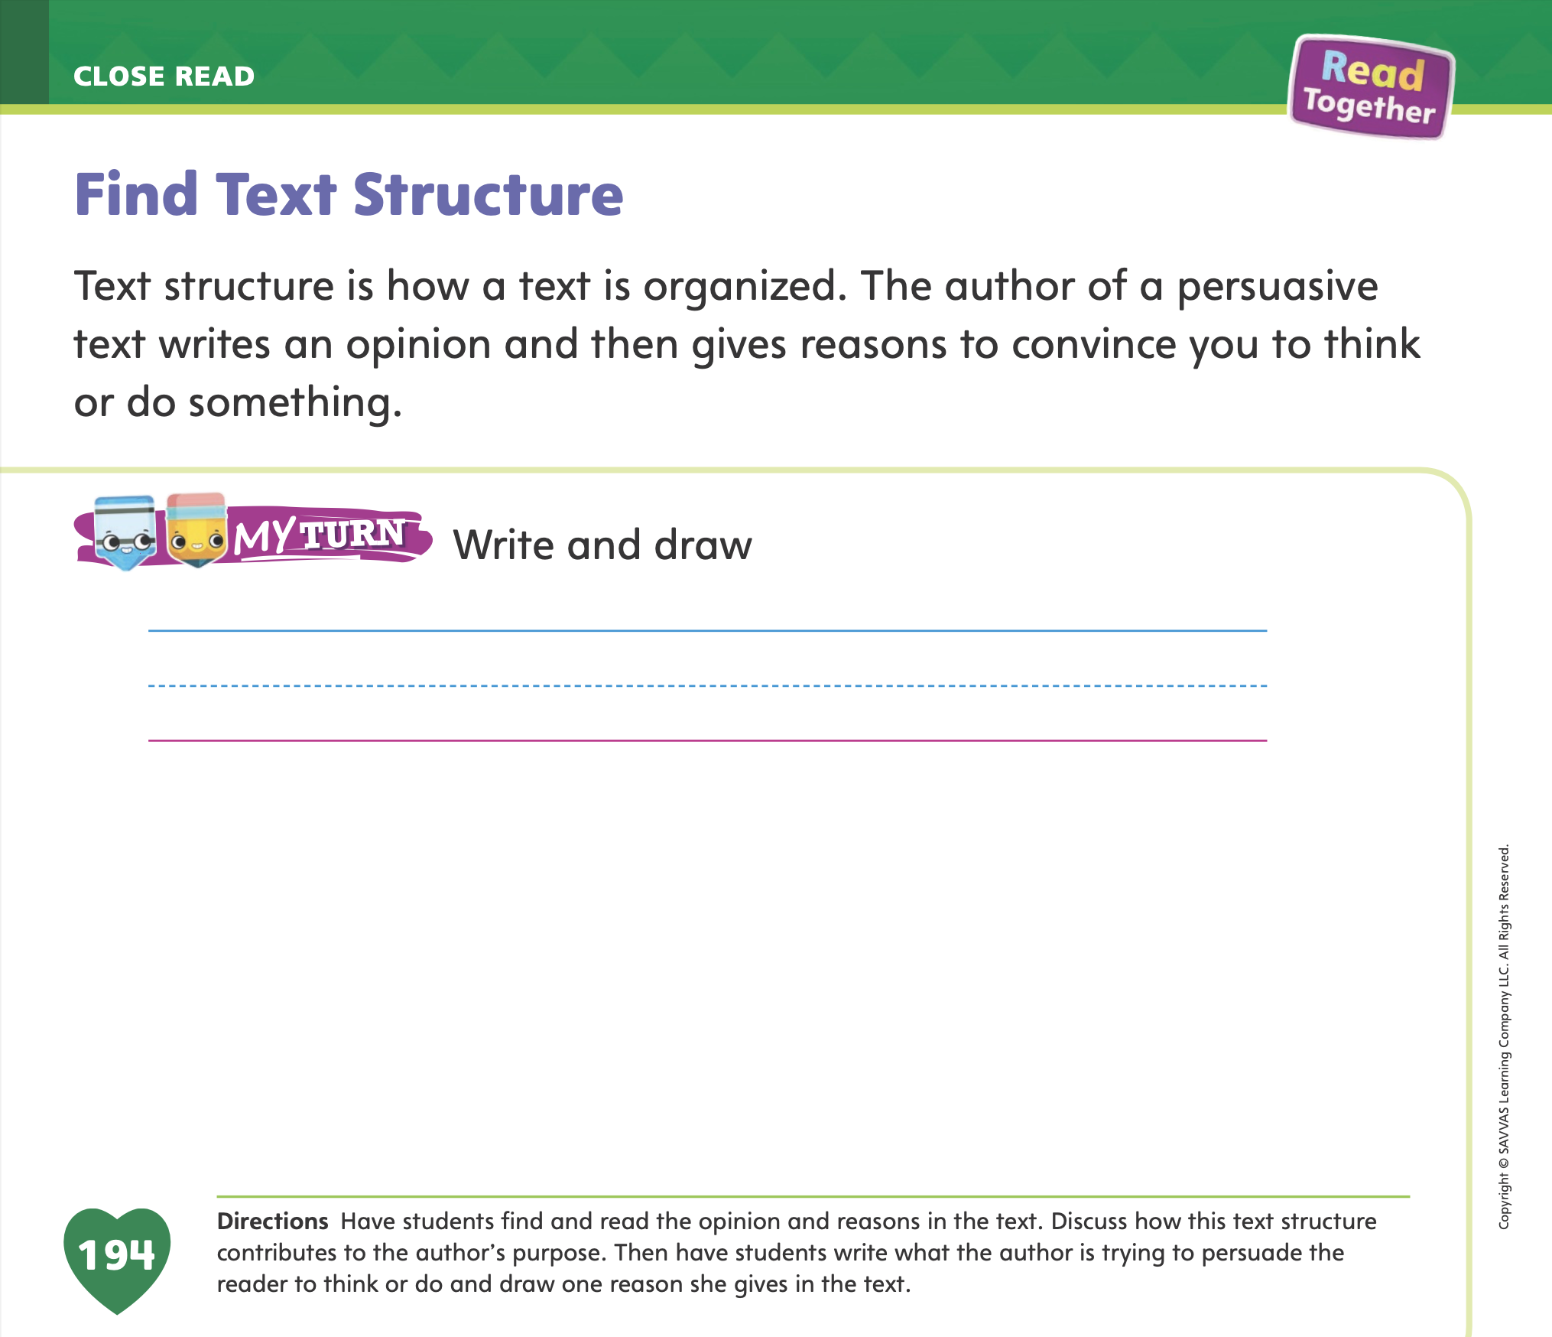
Page 194
Find Text Structure
Turn to page 194 in your Student Interactive and complete the activity.
Notes:
Have students use the strategies for recognizing how persuasive text structures contribute to an author’s purpose.
Have students complete the My Turn activity on p. 194 in the Student Interactive.

Slide 45
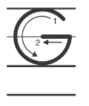

Handwriting
Notes:
Write an uppercase and lowercase Gg on the board. Explain that words beginning with /g/ are written with an uppercase G or a lowercase g. Ask students to identify the uppercase G and the lowercase g.
Write the name Gus on the board. Point to the uppercase G. This is uppercase G. We use uppercase to begin sentences and names. Watch as I trace the uppercase G with my finger. Show students where to begin the letter and how to properly form it. Have students trace uppercase G on their desks.
Write the word got on the board. This is the word got. Point to the lowercase g. This is the lowercase g. Watch as I trace this lowercase g on the board. Have students trace lowercase g on the surfaces of their desks.
Have students use Handwriting p. 85 from the Resource Download Center to practice writing Gg. Click path: Table of Contents > Resource Download Center > Handwriting Practice > U2W5L3 Handwriting Practice

Slide 46
Writing – List Book
Writing Checklist:
  My drawings are complete.
  My sentences are complete.
  I can read my book out loud.
Notes:
Before authors celebrate, they revise their work. They also practice reading their books so they will be ready when it is time to present in public.
Make a Writing Checklist for students to refer to as they revise their writing to prepare for the celebration.
Provide a basic checklist:
My drawings are complete.
My sentences are complete.
I can read my book out loud.
Reread each item on your classroom Writing Checklist. Ask students if they have any questions about what to check in their writing. Display your checklist so students can refer to it as they transition to independent writing.

Slide 47
Independent Writing
Edit and whisper read your list book.
Notes:
Students should use their independent writing time to do a final edit of their list books.
They should whisper read their book to practice for the celebration day.
Modeled As you look through a student's work, model using the checklist to revise.
Shared Have student identify how their work can be revised as they refer to the checklist.
Guided Prompt students to read each sentence and refer to the checklist.
As students write, use the conference prompts in the Teacher’s Edition or Resource Download Center to provide support. Click path: Table of Contents -> Resource Download Center -> Writing Workshop Conference Notes
Call on one or two students to share a page of their book with the class and describe a change they made during their final review.

Slide 48
Language and Conventions
I will teach class tomorrow.
John will go to school.
Jennifer will have fun with her friends.
Notes:
Explain to students that future-tense verbs tell what people will do in the future.
Write on the board: I will teach class tomorrow.
Explain to students that will teach is the future tense of the verb teach. It is about someone teaching in the future.
Model other examples. Say: John will go to school. Jennifer will have fun with her friends.
Explain to students that these sentences contain examples of future-tense verbs. Give more examples if necessary.

Slide 49
Lesson 4

Slide 50
Phonics
Notes:
Hold up the Ww Alphabet Card. This is a picture of a watermelon. I hear the sound /w/ at the beginning of watermelon. Say the sound /w/ with me. What letter makes the sound /w/? Have students identify the letter w. Write the letters Ww on the board. Have students write the letters Ww in the air as you lead them.
Hold up the Yy Alphabet Card. This is a picture of a yo-yo. I hear the sound /y/ at the beginning of yo-yo. Say the sound /y/ with me. What letter spells the sound /y/? Have students identify the letter y. Write the letters Yy on the board. Have students write the letters Yy in the air as you lead them.
Point to the letters Ww and Yy on the board. Then display the words wag and yet. Listen carefully as I read these words: wag, yet. One word has the sound /w/, and one word has the sound /y/. Listen carefully: /w/ /a/ /g/, /y/ /e/ /t/. Which word includes the sound spelled w? Have volunteers identify the word wag. Which word includes the sound /y/ spelled y? Have volunteers identify the word yet. Click path -> Table of Contents -> Unit 2 Week 5 Persuasive Text-> Lesson 3

Slide 51
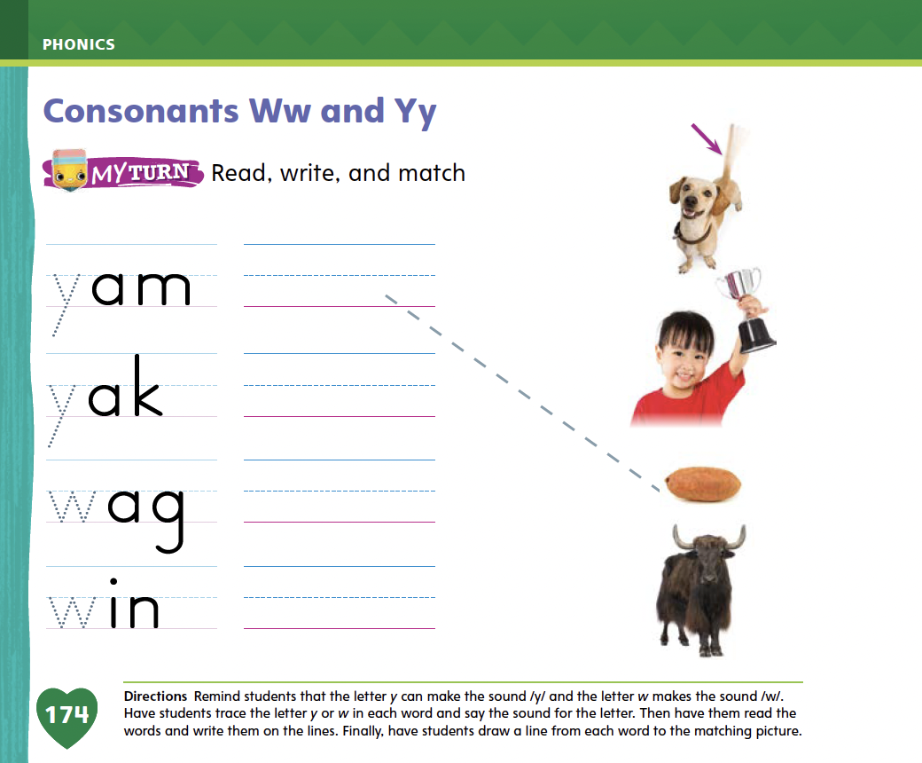
Page 174
Apply
Turn to page 174 in your Student Interactive and complete the activity.
Notes:
Hold up the Ww Alphabet Card. This is a picture of a watermelon. I hear the sound /w/ at the beginning of watermelon. Say the sound /w/ with me. What letter makes the sound /w/? Have students identify the letter w. Write the letters Ww on the board. Have students write the letters Ww in the air as you lead them.
Hold up the Yy Alphabet Card. This is a picture of a yo-yo. I hear the sound /y/ at the beginning of yo-yo. Say the sound /y/ with me. What letter spells the sound /y/? Have students identify the letter y. Write the letters Yy on the board. Have students write the letters Yy in the air as you lead them.
Point to the letters Ww and Yy on the board. Then display the words wag and yet. Listen carefully as I read these words: wag, yet. One word has the sound /w/, and one word has the sound /y/. Listen carefully: /w/ /a/ /g/, /y/ /e/ /t/. Which word includes the sound spelled w? Have volunteers identify the word wag. Which word includes the sound /y/ spelled y? Have volunteers identify the word yet.
Have students complete p. 174 in the Student Interactive.

Slide 52
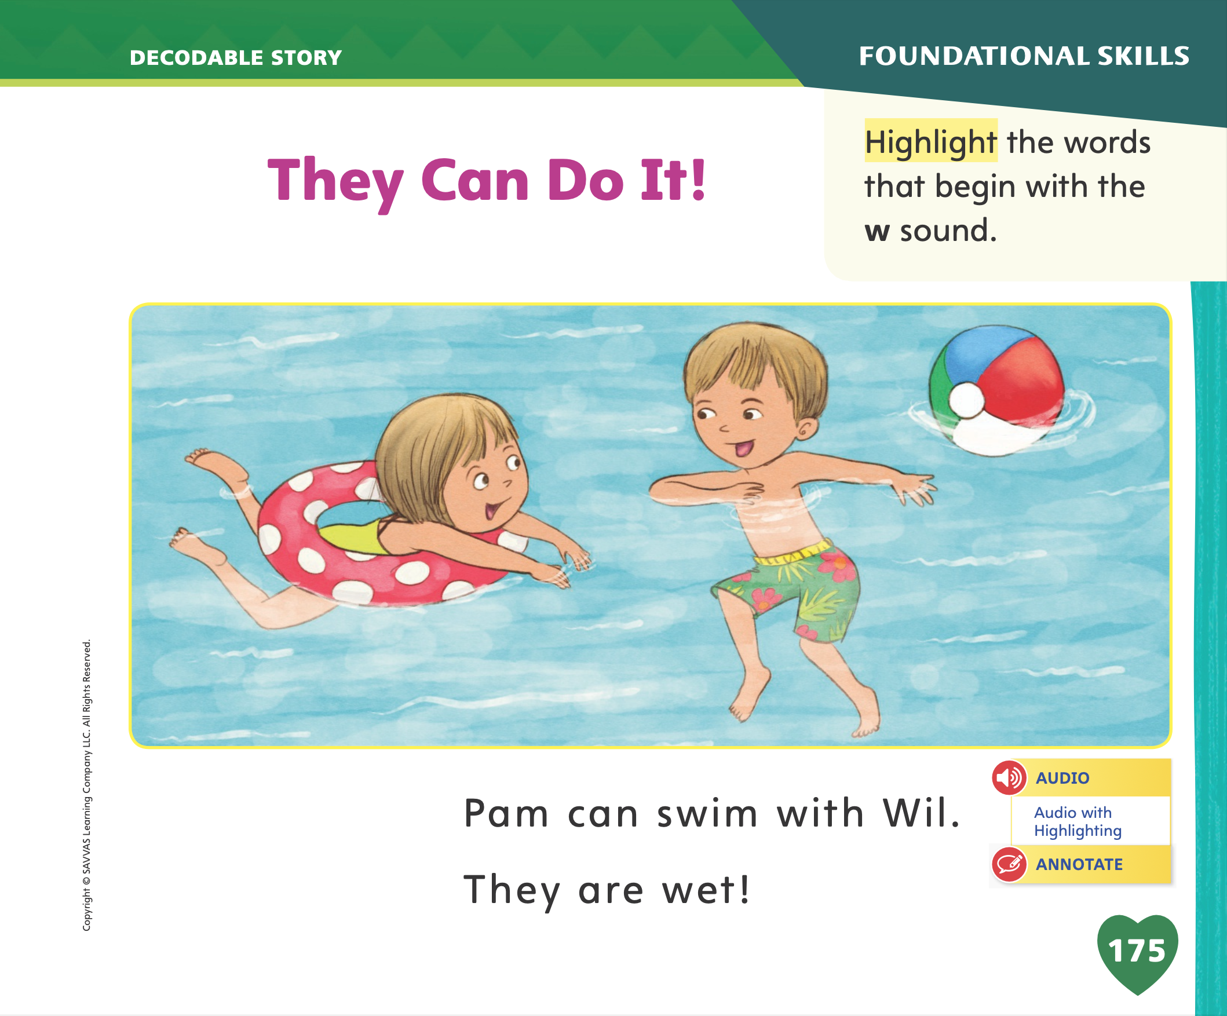
Page 175
Decodable Story
go
from
yellow
Turn to page 175 in your Student Interactive. We will Read “They Can Do It!”
Notes:
Have students turn to p. 175 in the Student Interactive. We are going to read a story today about activities children do. Point to the title of the story. The title is They Can Do It! Have students point to the word wet in the last sentence on p. 175. Listen as I read this word: /w/ /e/ /t/, wet. I hear the sound /w/ in this word. I also hear the sound /e/. What letter spells the sound /w/? Students should say w. What letter spells the sound /e/? Students should say e. In this story, we will read other words that have sounds you have learned.
Remind students of this week’s high-frequency words: go, from, yellow. Tell them they will practice reading these words in the story They Can Do It! Display the words. Have students read them with you. When you see these words in the story They Can Do It!, you will know how to identify and read them.

Slide 53
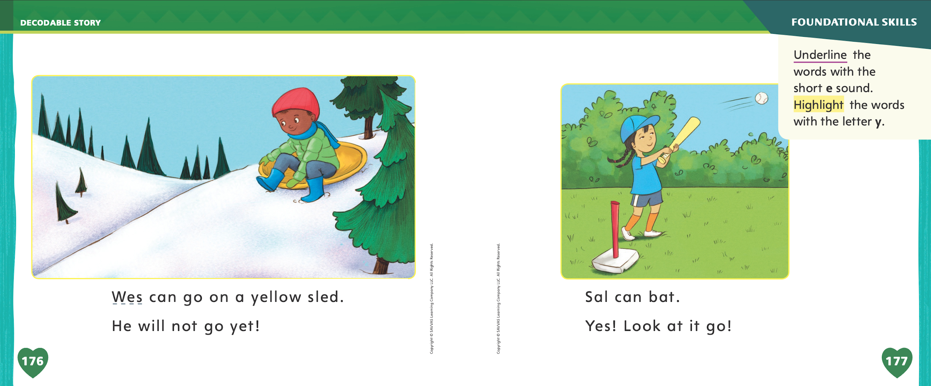
Page 176,177
Decodable Story
Notes:
Have students whisper read the story as you listen in. Next, have students reread the story page by page with a partner. Listen carefully as they use letter- sound relationships to decode. Partners should reread the story. This time the other student begins.
After students have read the story, call their attention to the first sentence on
p. 175. I hear the sound /w/ in this word: Wil. What letter spells the sound /w/? Help them identify, or say, the letter w. Then have students find and highlight the words on p. 175 that begin with the sound /w/ (Wil, wet).
Have students turn to pp. 176-177. Which words include the sound /e/? Point to them. Help students identify, or say, the sound /e/. Then have them find and underline the words Wes, yellow, sled, yet, and Yes. Which words include the sound /y/? Point to them. Help students identify, or say, the sound /y/ and then find and highlight the words with the letter y ( yellow, yet, Yes).

Slide 54
Page 183
Find Important Details
Notes:
Tell students that finding important details in a text can help readers better understand what the author is saying.
Readers can evaluate details to determine which ones are most important to a text.
Some important details are pieces of information that tell more about the main idea of the text.
Some important details are used to support an author’s point, whether in an informational or persuasive text.
Being able to identify important details in a text will help readers understand it. Important details are facts or pieces of information that together make a text complete and interesting to read.
Tell students that Run, Jump, and Swim has many important details in it that can help students understand the text. Instruct students to open their Student Interactive to p. 188. Assist them as they find important details in the text.
Look at pages 188 and 189. What details does the author give us here? She tells us about specific ways to exercise.
Look at the pictures on these pages. Can you identify any details in the pictures that help us understand more about exercise? Do any of the pictures support details in the text?
Look at the pictures on the Close Read note on page 189. Ask them to evaluate the details included in the pictures and text by deciding if the detail was helpful. Have students highlight the most important details.

Slide 55
Page 186, 187
Close Read – Find Important Details
Turn to page 184, 185 in your Student Interactive.
Notes:
Look at pages 186 and 187. Here the author is telling us why exercise is good. She is giving reasons, or evidence, to support her claim. Point out to students the Close Read note on p. 187 in the Student Interactive. Have them underline the reasons the author gives.

Slide 56
Page 188,189
Close Read – Find Important Details
Turn to page 188, 189 in your Student Interactive.
Notes:
Remind students that the author wants readers to know that they should exercise. Read aloud the question in the Close Read box. Ask students to find the important details on pp. 188–189. DOK 2

Slide 57
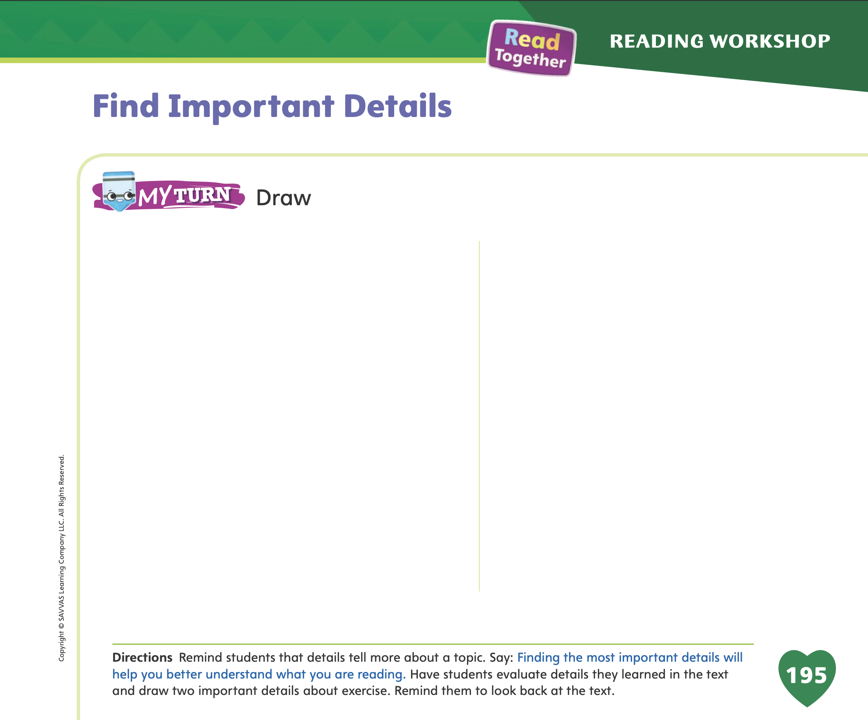
Page 195
Find Important Details
Turn to page 195 in your Student Interactive and complete the activity.
Notes:
Have students use the strategies for finding important details.
Have students complete the My Turn activity on p. 195 in the Student Interactive. Have them share their drawings with the class and explain the importance of the details drawn.

Slide 58
Writing – List Book
  My name is ___________ . Today I would like to share with you the book I have written, called is ___________ .
  Read your writing aloud to the class, speaking slowly and clearly.
Notes:
Celebrating student writing is an essential part in growing your students’ confidence and writing ability. While students perform at different levels, it is important to celebrate everyone’s progress. Students will be motivated to write throughout the unit if they have a goal to work toward.
Tell students that you will celebrate your writing by reading it aloud to the class. Before reading their books, students should introduce themselves and share the title of their book. Using a book you have written or a stack text, model the way you would present your book. My name is Mr./Mrs./Ms. _____. Today I would like to share with you the book I have written, called _____. Then read the book aloud, speaking slowly and clearly.
When you are finished reading, say: When you read your book, make sure you speak slowly and clearly so we can hear you. The rest of the class and I will listen without talking.

Slide 59
Independent Writing
You will Share your writing with the class.
Notes:
Have students share their writing with the class. Prompt students to ask questions and provide positive feedback or suggestions.
Modeled Do a Think Aloud to model how to reflect on the process of writing a list book.
Shared Ask questions to help students discuss their work. Transcribe their answers.
Guided Ask students guiding questions to help them reflect on the process they used to write a list book.
As students write, use the conference prompts in the Teacher’s Edition or Resource Download Center to provide support. Click path: Table of Contents -> Resource Download Center -> Writing Workshop Conference Notes
Intervention Refer to the Small Group Guide for support.

Slide 60
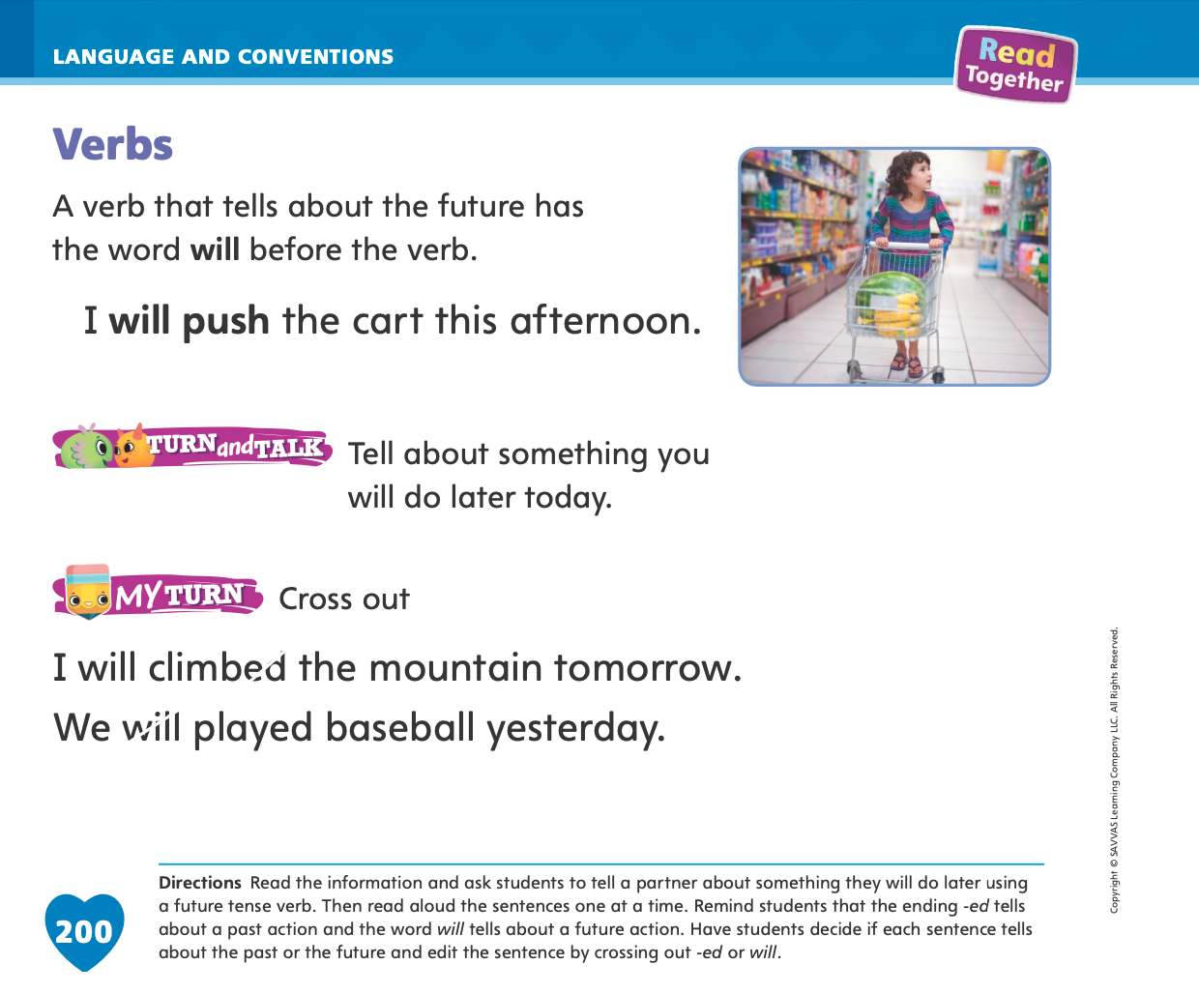
Page 200
Language and Conventions
Turn to page 200 in your Student Interactive and complete the activity.
Notes:
Have students apply what they have learned about future verbs by completing the My Turn activity on p. 200 in the Student Interactive.

Slide 61
Lesson 5

Slide 62


Phonological Awareness
Notes:
Tell students that words that have the same middle and ending sounds rhyme. The words wet and yet rhyme. They both have the middle and ending sounds /e/ /t/.
Display the red Picture Card. This is the color red. Say red with me: /r/ /e/ /d/, red. What is the middle sound in red? (/e/ ) What is the ending sound? (/d/). Then hold up the bed Picture Card. This is a picture of a bed. Bed rhymes with red. They both have the sound /e/ in the middle and the sound /d/ at the end. What other words can you think of that rhyme with bed and red? (Possible responses are fed, Ted, Jed, Ned, led, and wed.) Click path -> Table of Contents -> Unit 2 Week 5 Persuasive Text-> Lesson 3

Slide 63
Phonics
Ee Ww Yy
wet
yet
Notes:
Write the letters Ee, Ww, and Yy on the board. Have students identify the letters as you point to them. Then review the sound for each letter: e /e/, w/w/, y/y/. Ask students to say the sound as you point to each letter.
Write the words wet and yet on the board. The word wet starts with the consonant w and has the short e sound in the middle. The word yet starts with the consonant y and has the short e sound in the middle. Have students repeat the words after you.
Give each student three index cards. Ask students to write Ee on one card, Ww on one card, and Yy on one card. Then write the word web on the board. We will read this word together. Hold up the Ww card if you hear the sound /w/. Hold up the Ee card if you hear the sound /e/. Hold up the Yy card if you hear the sound /y/. Repeat with the words red, yet, wig, and yak.

Slide 64
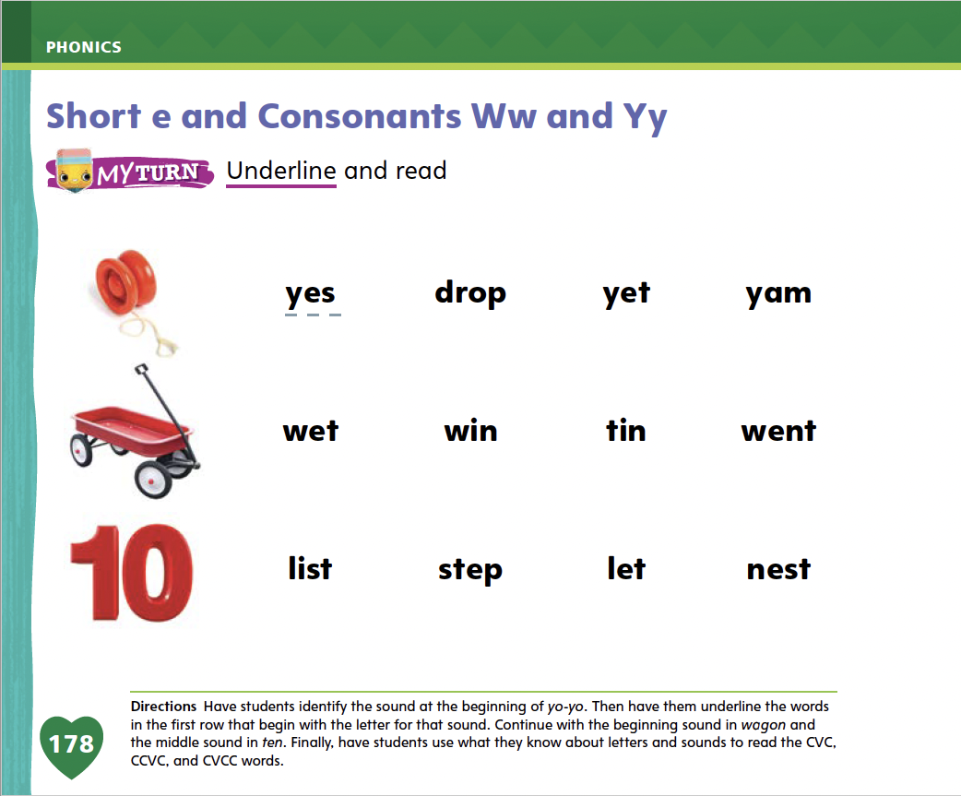
Page 178
Apply
Turn to page 178 in your Student Interactive and complete the activity.
Notes:
Have students turn to p. 178 in the Student Interactive. Have them identify the beginning sound in yo-yo and underline the words in the row that begin with the letter for that sound. Continue with wagon and ten. Then have students use letter-sound relationships to decode the words.

Slide 65
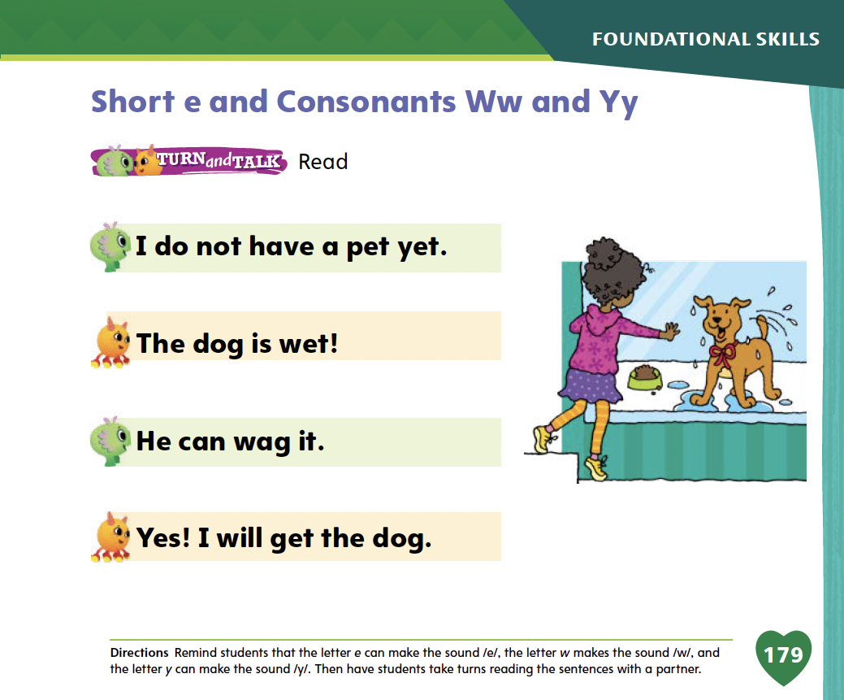
Page 179
Apply
Turn to page 179 in your Student Interactive and complete the activity.
Notes:
Have students look at p. 179 in the Student Interactive. Have partners read the sentences on the page.

Slide 66
High-Frequency Words
go
from
yellow
Notes:
Remind students that high-frequency words are words that appear over and over in texts. Remind them they will be learning many high-frequency words this year and knowing these words will help them become better readers. Say the word go and ask students what letters spells the word. Have students
say the letters as you write them on the board.
say and spell the word, doing a silent cheer for each letter.
repeat with from and yellow.

Slide 67
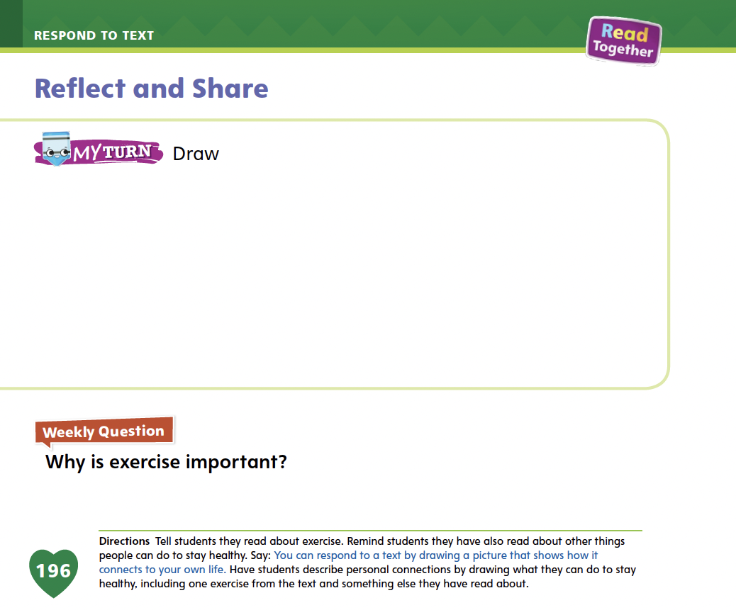
Page 196
Reflect and Share
Turn to page 196 in your Student Interactive.
Notes:
Explain to students that there are many ways to respond to something you read and make connections between a text and your own life. Writing or drawing about the connections to your own life experiences can make the text more meaningful to a reader.
Readers can draw connections between a text and past experiences.
Readers can also draw connections between a text and experiences they would like to have.
Readers can also make connections between the different texts they read, to find new ways of considering a topic.
Remind students that they read a short persuasive text about joining a soccer team on p. 180 in the Student Interactive. Tell them
that this short text can be connected to their lives.
Can I connect this text to my own life or experiences? I have played on a soccer team before. I got lots of exercise and had fun with my friends. My own life experiences make me think that the author is correct—that it is good to join a soccer team!
How does this text compare to Run, Jump, and Swim? Which text is more persuasive?

Slide 68
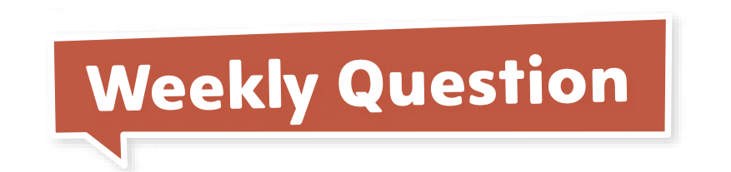
Page 196
Apply
How do some living things make what they need?
Notes:
Have students use the strategies for comparing texts and making connections between a text and their own lives and experiences.
Have students complete the My Turn activity on p. 196 in the Student Interactive. Then have them share their drawings with the class and explain what their drawings show.

Slide 69
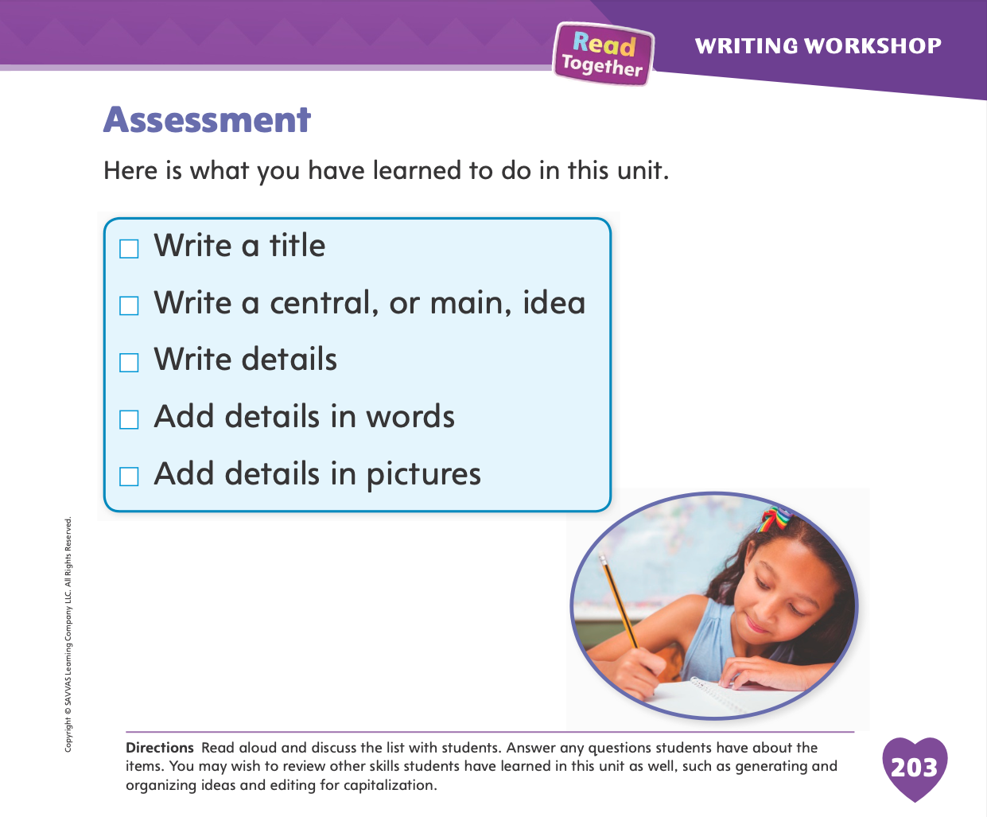
Page 203
Writing – Assessment
Turn to page 203 in your Student Interactive.
Notes:
Assessing student writing is important to help you evaluate if students have mastered the writing lessons or if they need additional support for a particular topic. Tell students that they should ask questions during the assessment so that they can understand the information that is important.
Tell students that they will be completing a writing assessment. Explain that just like in regular Writing Workshop, they will write a book. For this assessment, they should remember everything they have done in class. Remind students that they should ask questions to understand information during the assessment. Model asking a question, such as: How can you add detail to your writing? Then have partners briefly practice asking the question.
Afterward, direct students to the checklist on p. 203 in the Student Interactive. Say: This checklist will help you review the skills you have learned. Read each line and check the box if you understand the skill. Do not check the box if you do not understand the skill or are unsure about it. Your answers will show you what you need to review. This will help you get ready for the assessment.
Read aloud the checklist. Prompt students to ask for clarification if they don't understand what words mean. Have them check the boxes next to the items they understand.
Tell students that they are going to complete a writing assessment. Using the skills they have learned in this unit, they should respond to the prompt. Another form of assessment is to score students’ published writing using the rubric on p. T417.

Slide 70
Language and Conventions
Which sentence shows an example of a future verb?
1) Amy played with her toy.
2) Amy plays with her toy.
3) Amy will play with her toy.
1
2
3
2 and 3
Notes:
Display the following sentences. (1) Amy played with her toy. (2) Amy plays with her toy. (3) Amy will play with her toy.
Which sentence shows an example of a future verb?
A (1)
B (2)
C (3)
D (2) and (3)
Have students complete Language and Conventions, p. 90, from the Resource Download Center for further practice with future verbs. Click path: Table of Contents -> Resource Download Center -> Language and Conventions -> U2 W5

Slide 71
Unit 2: Week 5
Grade K

